Slide 1
Bring your data to life with Microsoft Power BI
Manpreet Singh
Cloud Solution Architect
George Chilakos
Data Platform Architect
Notes:
Welcome to this presentation!

Slide 2
Participant introductions
Please provide a brief introduction, including:
Name
Role
Prior Microsoft BI experience with:
Microsoft BI Stack
Azure Data Services
SQL Server
Definitely Microsoft Excel!
Notes:
Time permitting, based on class size, request a brief introduction from each attendee.
It may help to also ask for the #1 reason they are attending this training.

Slide 3
Course aim
Excite partners with the potential of Microsoft Power BI
Empower partners with the technical knowledge required to transform their business to sell Power BI solutions to their customers
Provide partners with ideas to identify opportunities, and with resources to help them take the next steps on their path to mastering Power BI
This course is suitable for Business Intelligence Developers, Architects and Practice Leads
As an introductory training course, there is no requirement to have existing Power BI skills
Notes:
The bullet points on this slide provide a concise summary of the course aim.
Ask the attendees if there is anything missing from this list that they expected would be included. Address any perceived expectation deficits upfront before the training commences.

Slide 4
Course outline
01: Microsoft Power BI overview
02: Creating Power BI Desktop solutions
03: Working with the Power BI service
04: Connecting to Power BI data sources
05: Power BI for the developer
06: Power BI Premium
07: Summary
Notes:
Briefly introduce the course consisting of six modules.

Slide 5

Lab scenario
The labs in this training course are based on the sales activities of the fictitious Tailspin Toys company
The Tailspin Toys company:
Represents a specialist toy sales business that sells model airplanes and helicopters to global markets
Accumulates core sales data in a Azure SQL database, and is interested to explore, discover and share deeper insight from this data
As a developer/analyst for Tailspin Toys, you will implement various Microsoft Power BI solutions
Notes:
Introduce the lab scenario and stress that the attendees are acting as an IT consultant for the Tailspin Toys company.
You can use this slide to generate excitement around the hands-on labs.

Slide 6
Quick Check
Power BI Pro trial subscription
Download Labs for today’s workshop:
https://aka.ms/pbitraining0713

Slide 7
Questions?
Notes:
Use this slide to ask any remaining questions before commencing the course.

Slide 8
01 Microsoft Power BI overview
A new generation of BI
Introducing Microsoft Power BI
Power BI overview
Signing up for Power BI
A message for partners
Notes:
Introduce the module title and topics.

Slide 9
A new generation of BI
Today, BI extends to everyone
3rd wave End user BI
Everyone
2nd wave Self-service BI
Analyst to end user
1st wave Technical BI
IT to end user
Notes:
Key message:
Today BI extends to everyone.
Business intelligence, or BI, has come a long way.
During the first two waves of business intelligence, IT professionals and business analysts were the guardians of BI. They made BI accessible and consumable for end users.
While this approach still applies to complex business intelligence needs, today there is a new wave.
This third wave of BI makes BI available to every kind of user.
Talking points:
Today we’re going to discuss Power BI, which is a third-wave solution. Power BI enables EVERYONE to collect, analyze, visualize and publish data.
This third wave has the potential to expand the reach of analytics to more users than ever before. Existing analytics platforms and tools can be extended, instead of being replaced, by full-featured solutions like Power BI. Power BI directly connects to existing on-premises data, such as Analysis Services tabular models that were created by business analysts in collaboration with IT. Microsoft Excel and the new Power BI Desktop work hand-in-hand with Power BI, publishing reports and models created by business analysts and getting them more easily in the hands of the business users who can gain insight and take action.

Slide 10
A new generation of BI
Turning data into business insights is challenging
Common BI challenges include…
End-to-end view
Data often resides in disparate locations, making it difficult to see a complete picture of your business
Multiple data sources
Data residing in SaaS solutions, and other external locations, is difficult to access and refresh securely
Right data for the right users at the right time
Different roles have different needs, and business users need the latest operational data
Notes:
Power BI has been designed to address three common business intelligence challenges that an organization may face today:
Getting an end-to-end view off what is happening — because data is often in disparate locations, it can be difficult for business users to see a complete picture of your business
Managing multiple data sources — Data residing in SaaS solutions and other external locations can be difficult to manage programmatically, or access and refresh securely
Making the right data available to the right users at the right time
Mobile business users need the latest operational data at their fingertips, no matter where they are or what device they’re using
Different roles have different needs and access levels, so a one-size-fits all solution doesn’t necessarily work

Slide 11

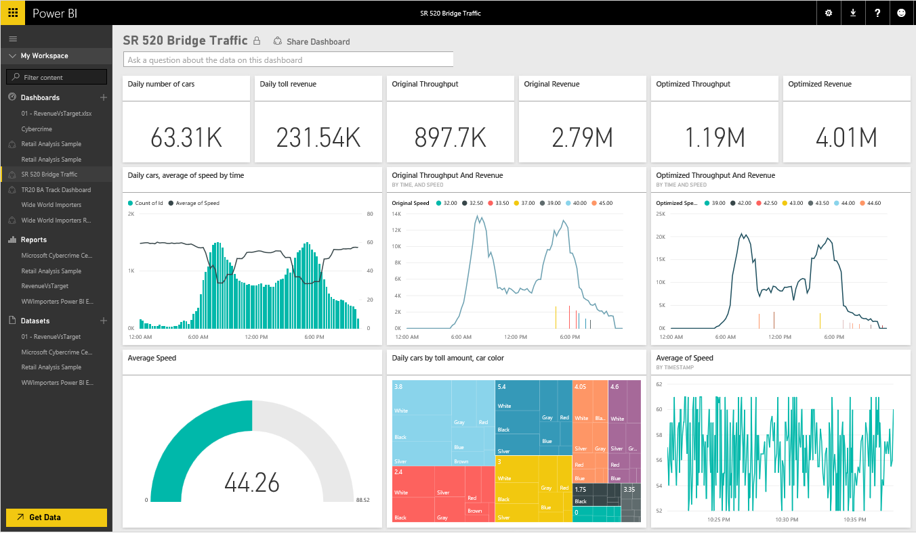
Introducing Microsoft Power BI
Experience your data. Any data, any way, anywhere.
Power BI is a cloud-based business analytics service that enables:
Fast and easy access to data
A live 360º view of the business
Data discovery and exploration
Insights from any device
Collaboration across the organization
Anyone to visualize and analyze data
Power BI
Notes:
Key message:
Power BI has been designed as a cloud based business analytics service. With Power BI you can now see all of your data through a single pane of glass. Live Power BI dashboards and reports show visualizations and KPIs from data residing both on-premises and in the cloud, providing a consolidated view across your business regardless of where your data lives.
Talking points:
This is Power BI in a nutshell and the overall benefits to your business. We will look at what this means for the IT Pro and the key benefits for IT on the next slide
Captions
Power BI has been designed as a cloud-based business analytics service.
That enables fast and easy access to data whether from on-premises whether from cloud.
It presents a live 360 degree view across the business, supporting data discovery and exploration, insights from any device.
Collaboration across within the organization and anyone, providing them the ability to visualize and work with to analyze their data.

Slide 12

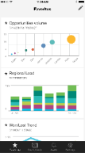
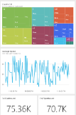
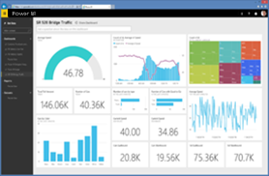
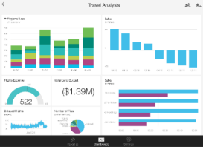
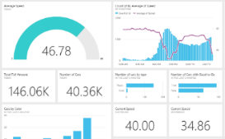

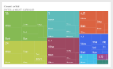
Introducing Microsoft Power BI
Key benefits and differentiators
Pre-built content packs, consisting of dashboards and reports, for popular SaaS solutions
Real-time dashboard updates
Secure, live connection to your data sources, on-premises and in the cloud
Intuitive data exploration by using natural language query
Integration with familiar Microsoft products, and commitment for scale and availability in Azure
Fast deployment, hybrid configuration, secure, and integrated with existing IT systems
Notes:
Captions:
Let's explore the key benefits and differentiators.
Pre-built content packs, consisting of dashboards and reports, for popular software as a service solutions.
Including Google Analytics, including Bing and a growing number of providers present quick to access content.
Real-time dashboard updates, the ability to present data real-time, pragmatically or through streaming analytics is a compelling experience.
Secure, live connection to data sources whether they on-premises or cloud.
So, the ability to surface, for example, analysis services models from on-premises for live reporting and analytics through the cloud service.
Intuitive data exploration by using the natural language query.
By posing questions within a dashboard, responses are delivered through visualizations that may also be pinned back to the dashboard.
Integration with familiar Microsoft products and commitment for scale and availability in Azure.
And lastly, fast deployment, hybrid configuration, secure and integrated with existing IT systems.
All of these benefits will be described within the series on Power BI.
Key message:
There are several capabilities that differentiate Power BI from other offerings in the market.
Talking points:
Power BI is a cloud-based analytics service that provides faster time to insight. It is used for visualizing, exploring and extracting insights from data. It brings together data from diverse sources to deliver rich, comprehensive views of business operations.
What that means is, with Power BI, you can see all of your data through a single pane of glass, and create an analytics environment in minutes to monitor data and share reports. Live dashboards and reports show visualizations and KPIs from data that reside both on-premises and in the cloud, providing a consolidated view across your business regardless of where your data lives.
There are several capabilities that are unique to Power BI – these include:
Pre-built dashboards and reports for popular SaaS solutions such as Marketo, Salesforce, GitHub, ZenDesk, Dynamics CRM, and many others
Dashboards and visualizations that support real-time updates
Secure, live connection to on-premises data sources to drive insight across the entire range of organizational information (Analysis Services, Azure SQL Database, SQL Database Auditing, Azure SQL Data Warehouse)
Automated scheduled refresh to keep your Power BI data in sync with on premises data sources
Native mobile applications for keeping users connected on the go
Easy integration with other Microsoft offerings, from Excel to Azure services
Intuitive data exploration, which enables users to ask questions of their data in plain English
To summarize, Power BI is a SaaS offering that enables anyone to easily connect to their data, create live operational dashboards and explore data via interactive visualizations

Slide 13
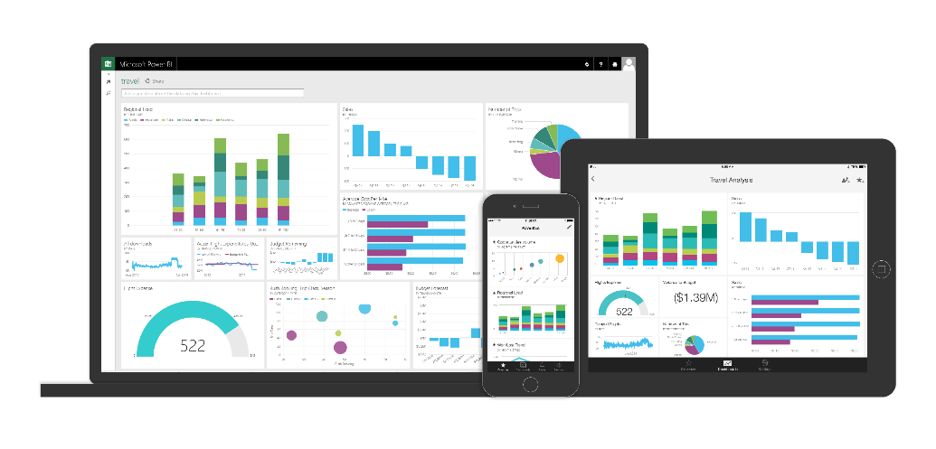















Power BI: experience your data Any data, any way, anywhere
MICROSOFT CLOUD
INTELLIGENCE
MICROSOFT CLOUD
Stream Analytics
Machine Learning
NON-MICROSOFT CLOUD
NON-MICROSOFT CLOUD
200,000 organizations 5,000,000+ users
200+ countries
Statistical Analysis
ON-PREMISE DATA
ON-PREMISE DATA
Intelligent Apps
Notes:
Power BI is a cloud-based business analytics service that enables anyone to visualize and analyze data with greater speed, efficiency, and understanding. It connects users to a broad range of live data through easy-to-use dashboards, provides interactive reports, and delivers compelling visualizations that bring data to life.
Through of the course of the preview over 45,000 companies, 500,000 users, cross 185 countries have used Power BI. That is a decade's worth of growth in last generation business intelligence where I have to go get software, install software, get servers, get analysts involved, get all sorts of people involved before anyone got any value, that's a long road from "I want to do it" to "I've done it". With Power BI, this is an enormous user population of people that are now connected with data in a way that was either previously very difficult or for many impossible.
Power BI in many ways is a connector between people and the power of the Microsoft Data Platform including data that lives in our cloud, other peoples clouds, or your on-premise systems and also processed by this wide variety of intelligence analytical capabilities that we have - statistical analysis, machine learning, building custom application - all of this technology and the value of converting data into intelligence flows through Power BI.

Slide 14
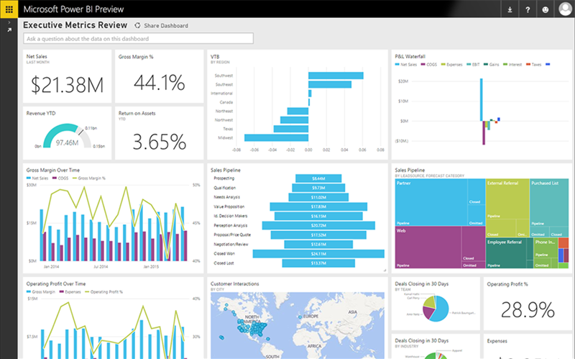
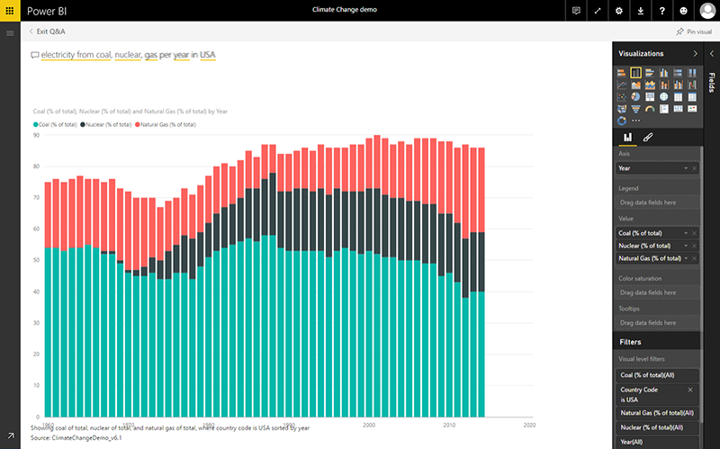
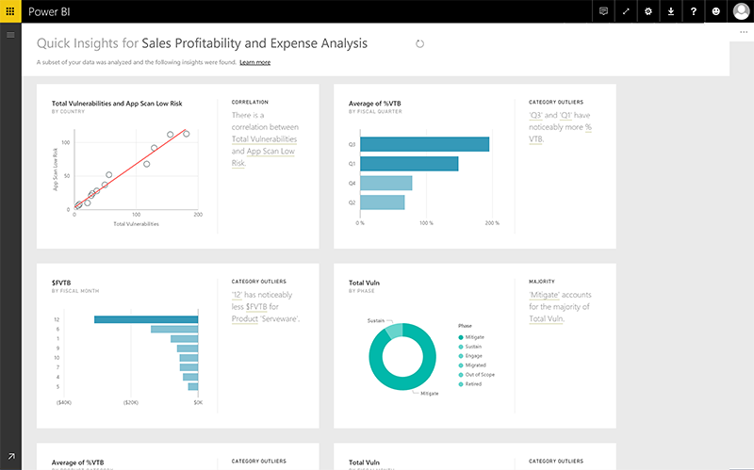
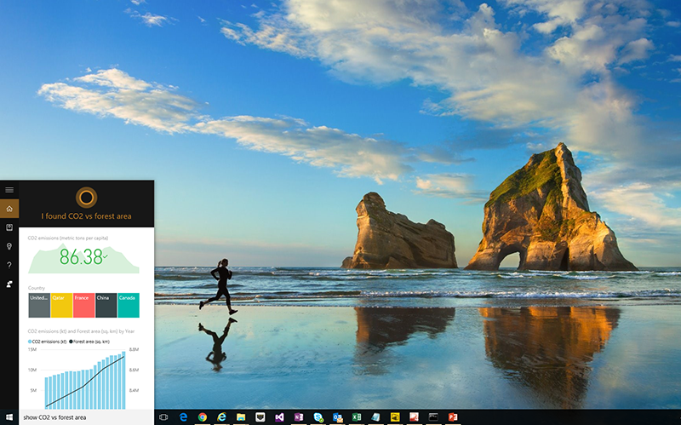
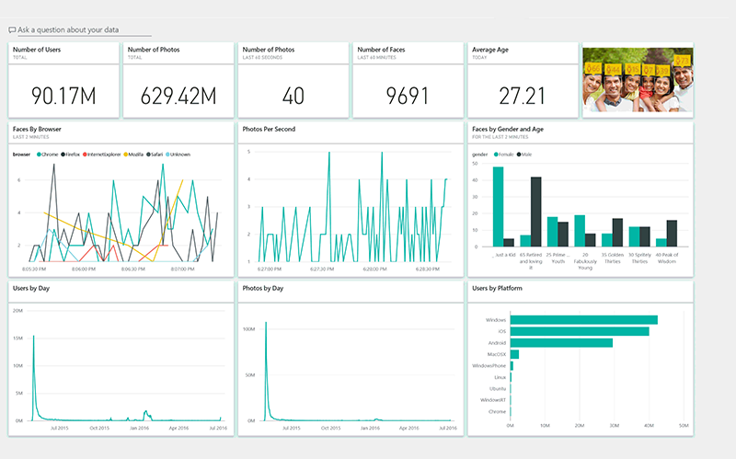
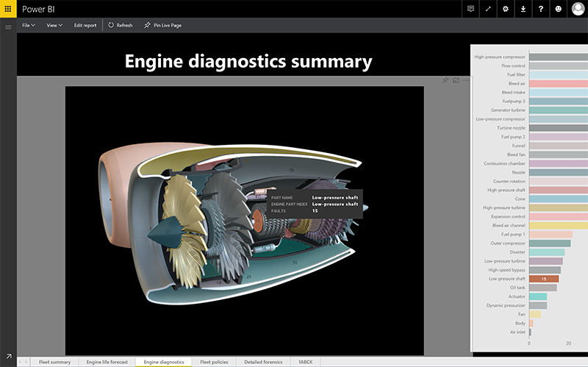
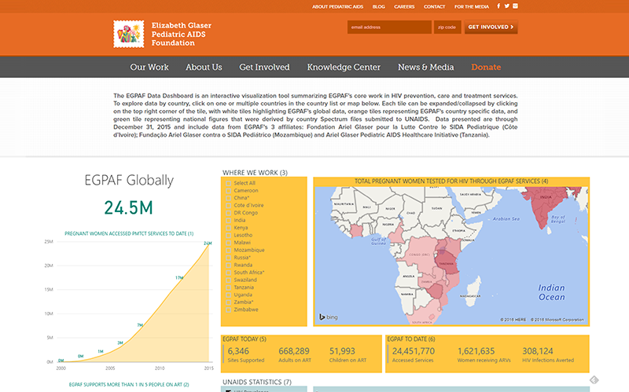
Power BI
Differentiators
Notes:
Let’s go through some of the key Power BI features, Because of these differentiators, Gartner and Forrester have put us ahead of our competitors.

Slide 15

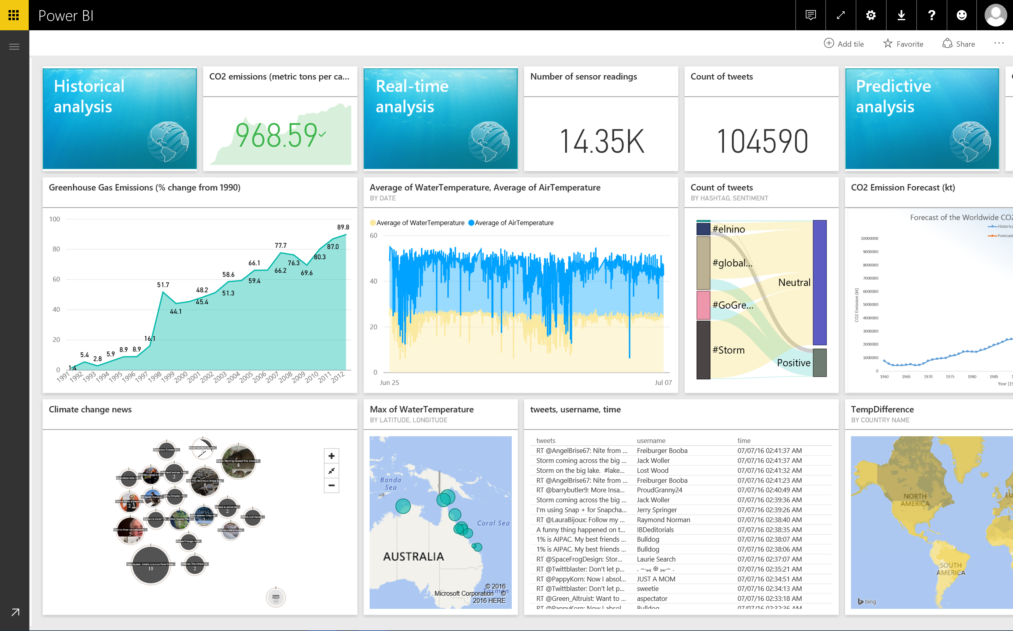
Get dashboards
in minutes
abc
Notes:
With Power BI, business users can sign up in 5 seconds, and within 5 minutes can get real business value from their data. It can pretty much connect to any data source whether it is Microsoft cloud, non-Microsoft cloud or even on-premise data. Power BI ships with hundreds of connectors that make getting access to all this data very simple. Within minutes see your data in new ways, thanks to content packs. Pre-built dashboards and reports by popular service providers like Salesforce or google analytics.

Slide 16
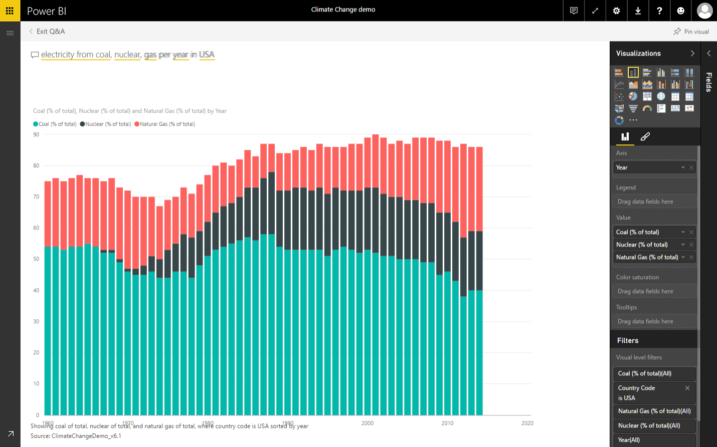
Natural language query
Electricity from coal, nuclear, gas per year in USA
abc
Notes:
No need to learn new language with Power BI. Customers value the ability to ask questions in natural language. We have invested in our natural language capabilities for several years now and we have industry leading capability on this front.

Slide 17

Quick Insights
abc
Notes:
Have a new dataset and not quite sure where to start? Need to build a dashboard fast? Want to quickly look for insights you may have missed?
Run Quick Insights to generate interesting interactive visualizations based on your data

Slide 18
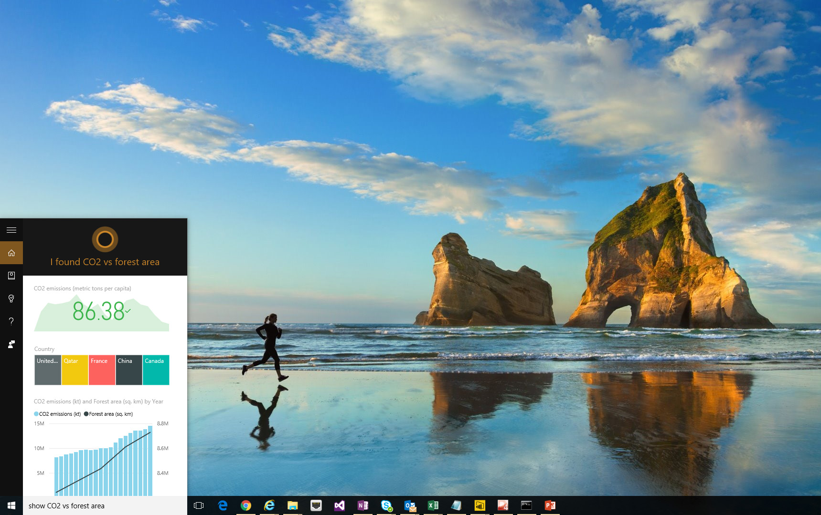
Cortana
integration
abc
Notes:
Use Cortana across your Windows 10 devices to get instant answers to your important business questions. By integrating with Power BI, Cortana can retrieve key information directly from Power BI datasets and reports. Interact with the data visualizations in Cortana or open the answers in Power BI to explore further. When you ask Cortana a question using the title (or keywords) of one of these answer cards, Cortana shows you the answer -- without you having to navigate to Power BI. When you use Cortana to ask a question, Power BI can be one of the places Cortana looks for answers.

Slide 19
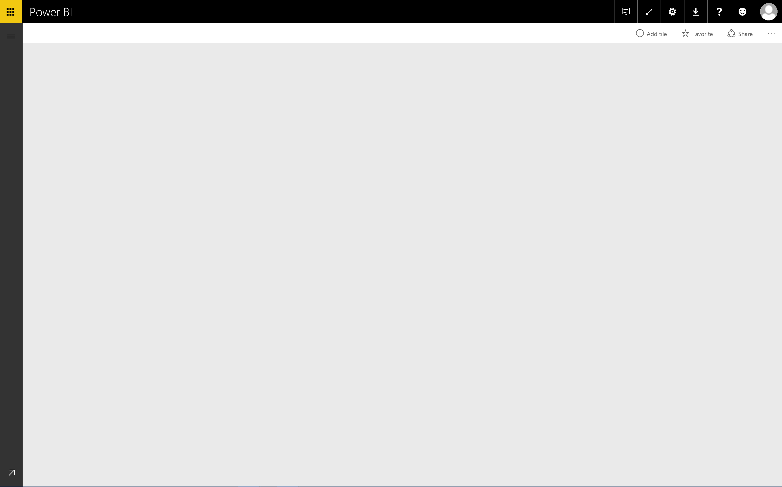
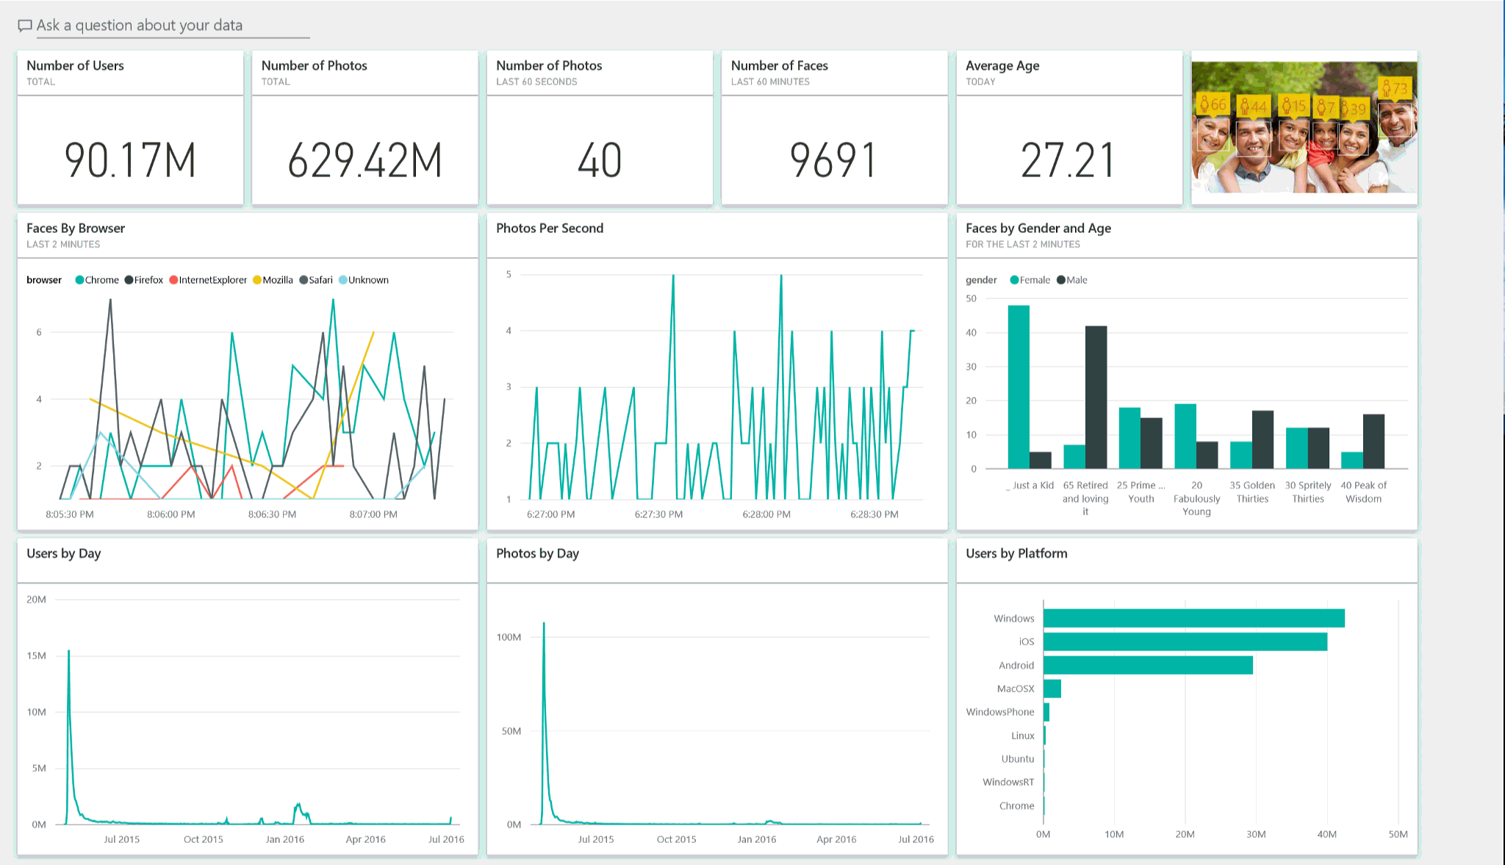
Live
dashboards
abc
Notes:
It is not only important for customers to understand what happened yesterday, last week, or last month but also to understand things as they are happening in real time. As a SaaS service built in Azure, Power BI has native capability to support real-time dashboards.

Slide 20

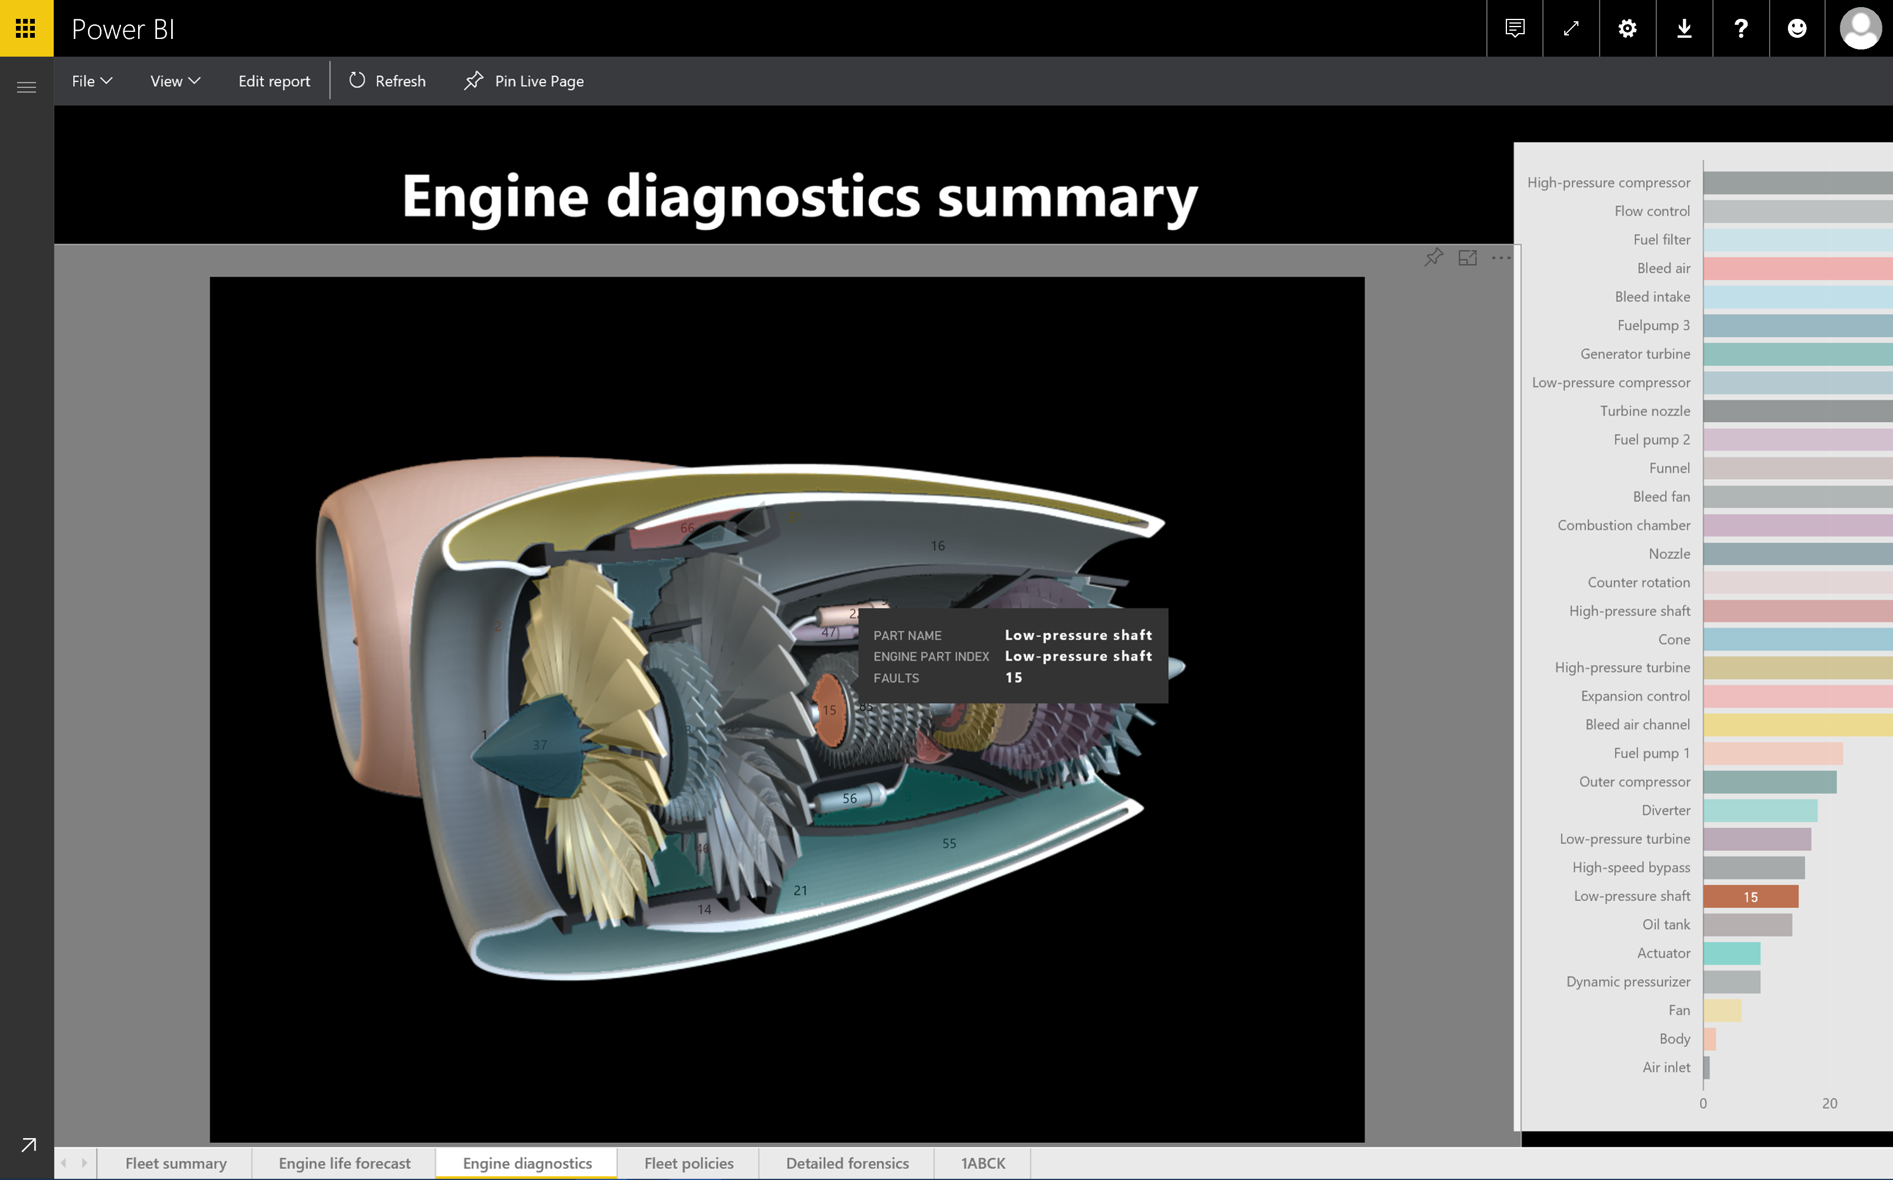
Custom visualizations
abc
Notes:
: Power BI has taken the step to open source all visualizations we ship on GitHub. They are all built in Node GS and D3. The purpose of doing that is that we want Power BI in the hands of a billion users; we recognize that even though we ship a wide variety of visuals out of the box, there are always situations unique to industry or unique to a customer where there is a need for a visual that we do not ship out of the box. By open sourcing our visuals and encouraging our third party community building visuals, we make it super simple for customers.

Slide 21
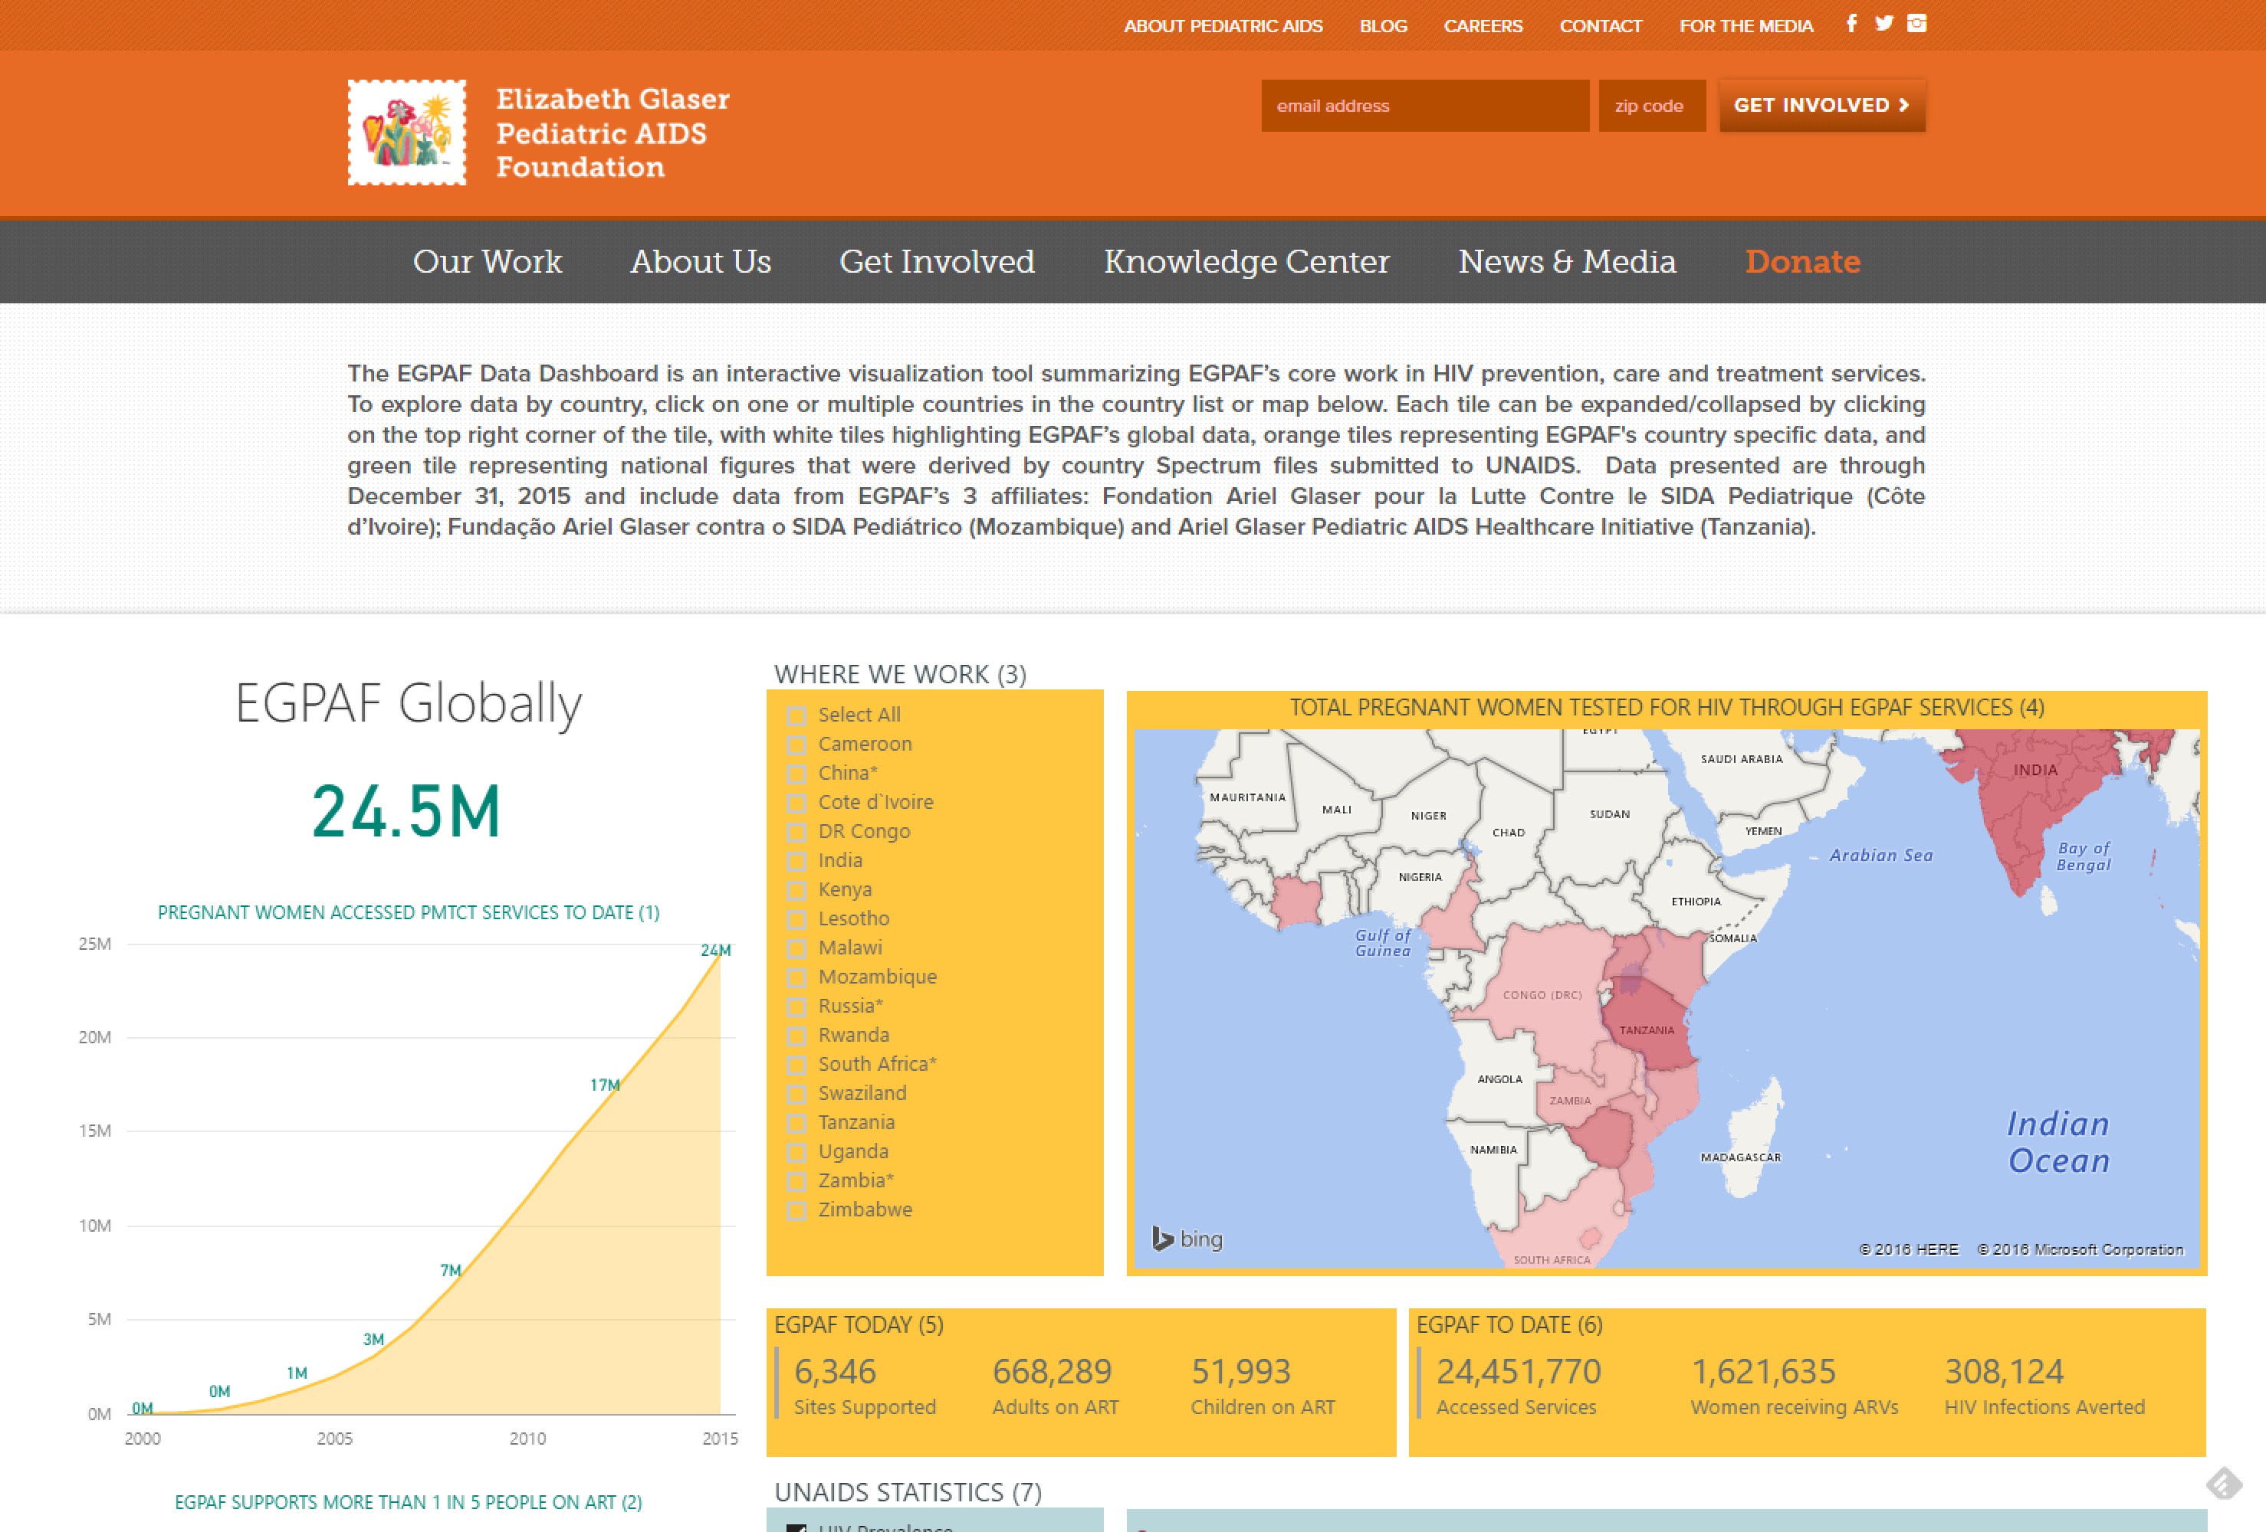
New screenshot needed? Please provide if possible
Publish to the web
abc
Notes:
Nonprofits are doing more good with Power BI publish to web. With Power BI Publish to web, you can easily embed interactive Power BI visualizations online, such as in blog posts, websites, through emails or social media, on any device.
You can also easily edit, update, refresh or un-share your published visuals.
The EGPAF (Aids foundation) Data Dashboard is an interactive visualization tool summarizing EGPAF’s core work in HIV prevention, care and treatment services. Deliver data to variety of audiences to tell ther story and highlight efforts to end Aids in children worldwide.

Slide 22
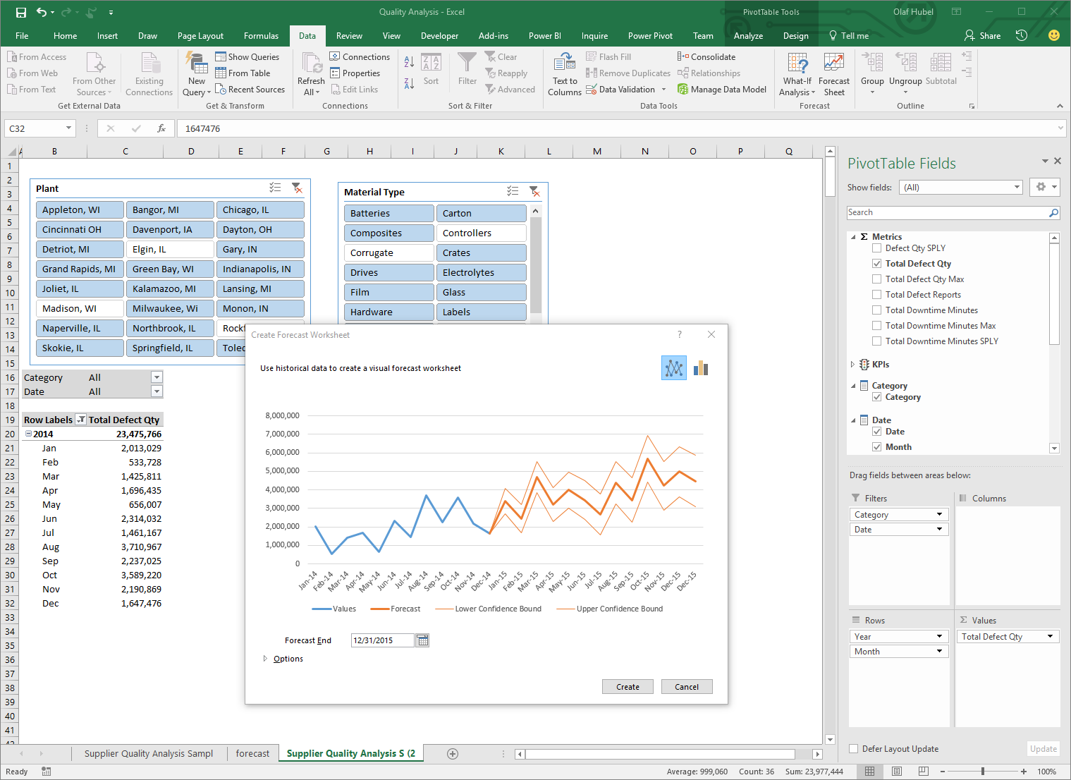

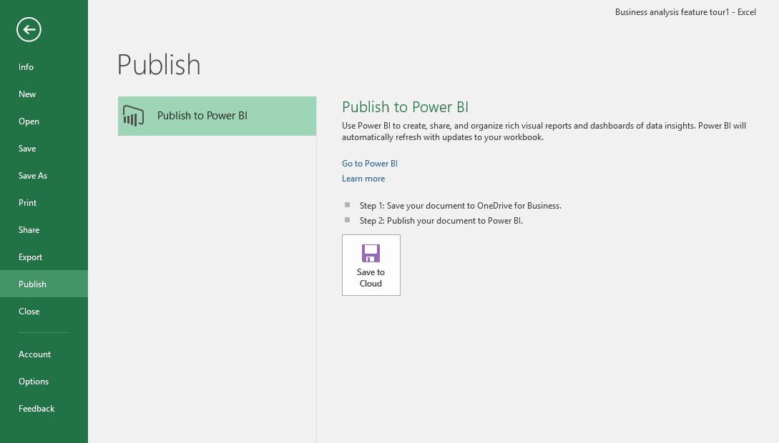
Integration with
Microsoft apps
& services
abc
Notes:
Power BI is 100% compatible with Microsoft Excel, because a lot of our customers have so much data and so much information sitting in excel, Power BI can not only bring in the data from Excel, but also import Excel workbooks, Excel data models, and Excel visualizations directly into Power BI. Power BI can even fully render Excel reports as-is if that’s what the customer requires. Power BI can also do the reverse. It can connect from Excel to the data models published in Power BI so that business analyst can work with those data models and pivot data the way they want. No other system can do that.
Team collaboration through support for Office 365 Groups
Seamless navigation to other workloads in Office 365
Use Excel data and pin live charts to your Power BI dashboards
View Excel spreadsheets through support for Excel Online

Slide 23
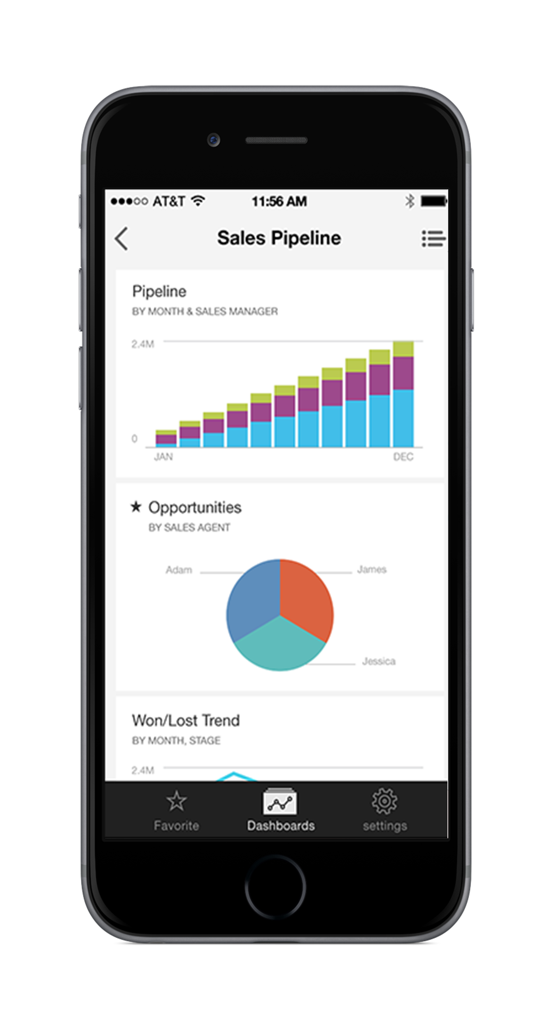
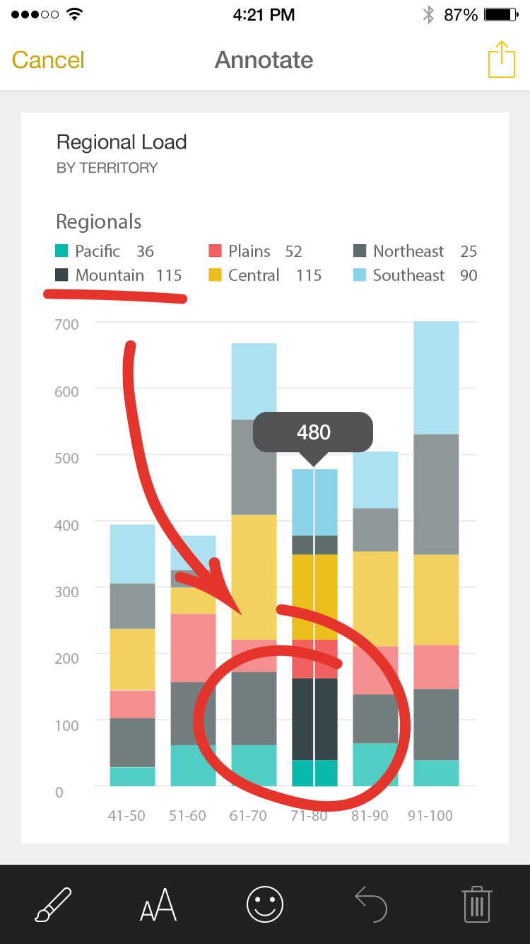
New screenshot needed? Please provide if possible
Power BI Mobile
abc
Notes:
Now that you have these visualizations built by Power BI Desktop, those can be made available to any device on any location. Customers can many different ways of accessing them. They can access them on mobile devices as we have native application for iOS and Android. They can access them on their PC or even access them on HoloLens in mixed reality environments.
Power BI can also be embedded completely into any business application, and that is Power BI Embedded. You can work with any data, you can transform the data and you can allow customers to consume the stunning visualizations anyway they want to.
Native apps for iPad, iPhone, Android and Windows devices
Receive alerts to important changes in your data
Share and collaborate with colleagues and take action
Mobile Q&A

Slide 24
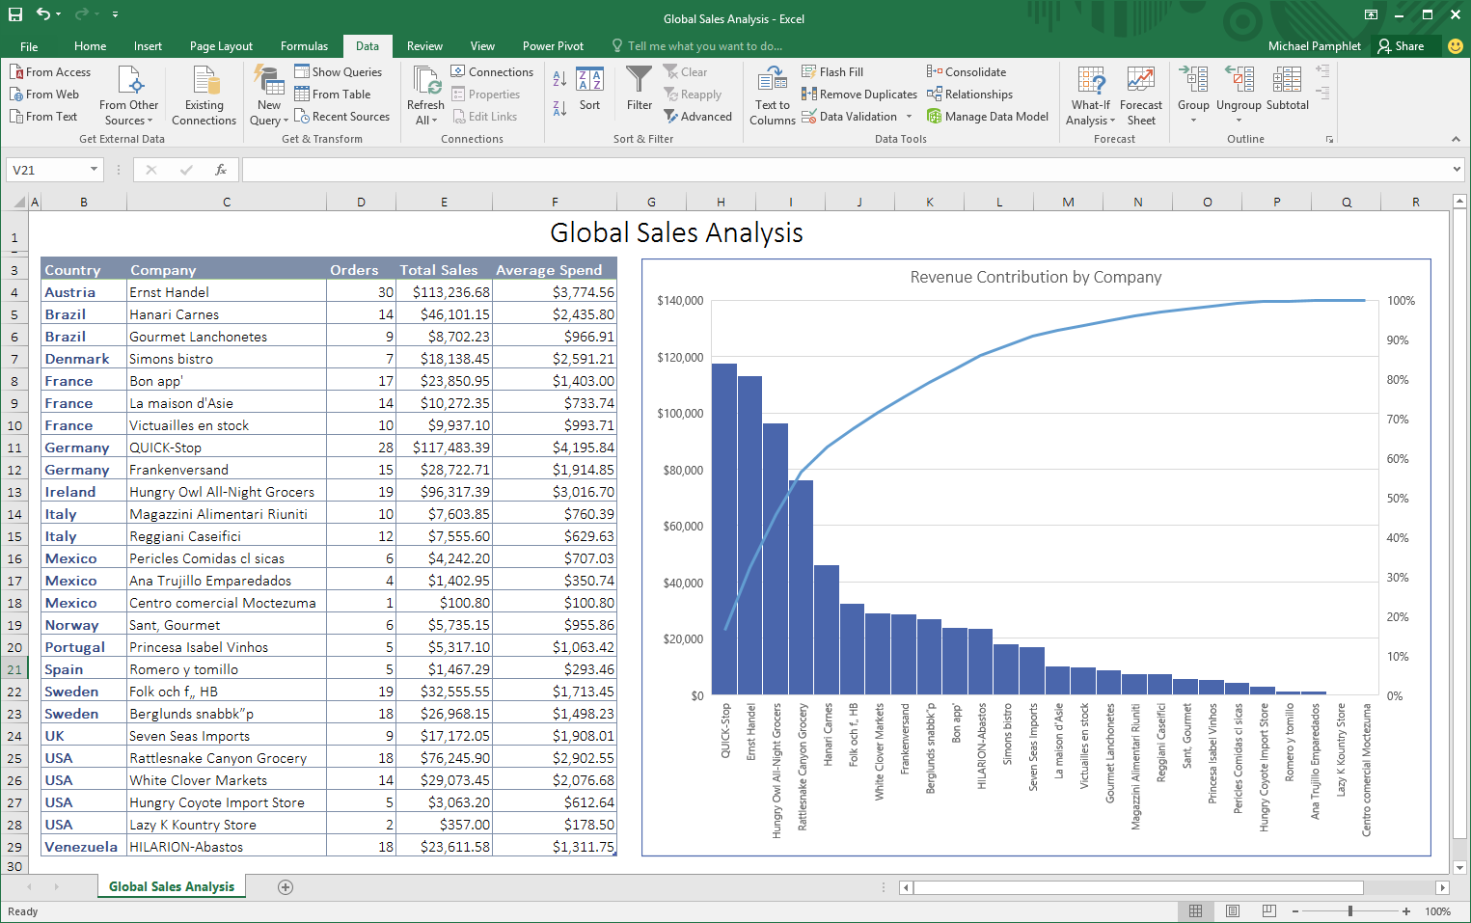
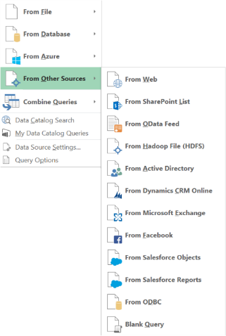
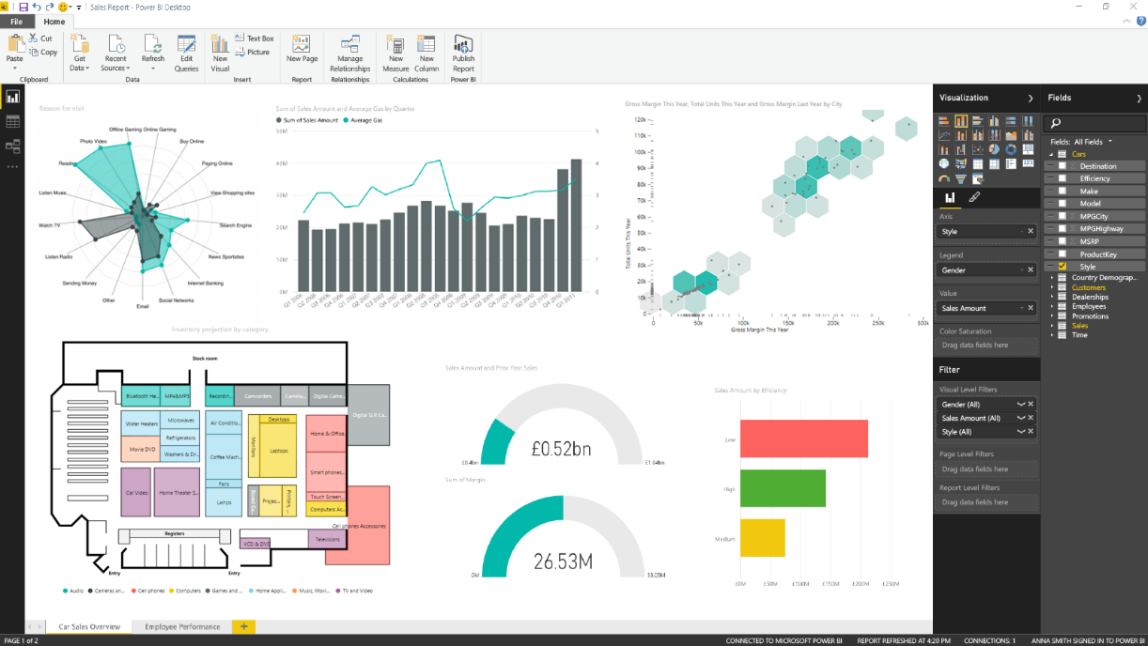
Powerful self-service analysis
Power BI Desktop Visual drag-and-drop data exploration and interactive reporting
Excel Ad-hoc analysis for blending structured and unstructured data
Notes:
Excel as the world’s most flexible and widely used data analysis tool, providing familiarity and flexibility when working with data in the context of the Excel grid and native charts and graphs. Excel uniquely allows users to perform ad-hoc analysis, blending structured and unstructured data together for analysis in the familiar Excel environment.
We also introduce Power BI Desktop an a tool for business analysis to create visually interactive reports for data exploration. Power BI Desktop provides a free-form canvas for drag and drop exploration of your data, an extensive library of interactive visualizations, and authoring experience to create visual and interactive reports for business end users to view and explore.
In addition we provide the ability for you to create your own Power BI custom visualizations. We have contributed the source code of our visualization framework and the complete collection of native visuals supported by Power BI and Power BI desktop to the open source community under the permissive MIT license. This paves the way for completely custom visualizations in Power BI and Power BI Desktop. These can be uploaded to your Power BI tenant, or attached to a report, providing maximum flexibility for how you visualize your data.

Slide 25







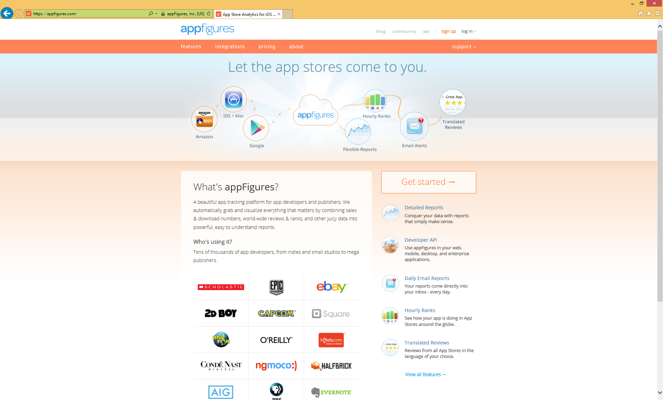






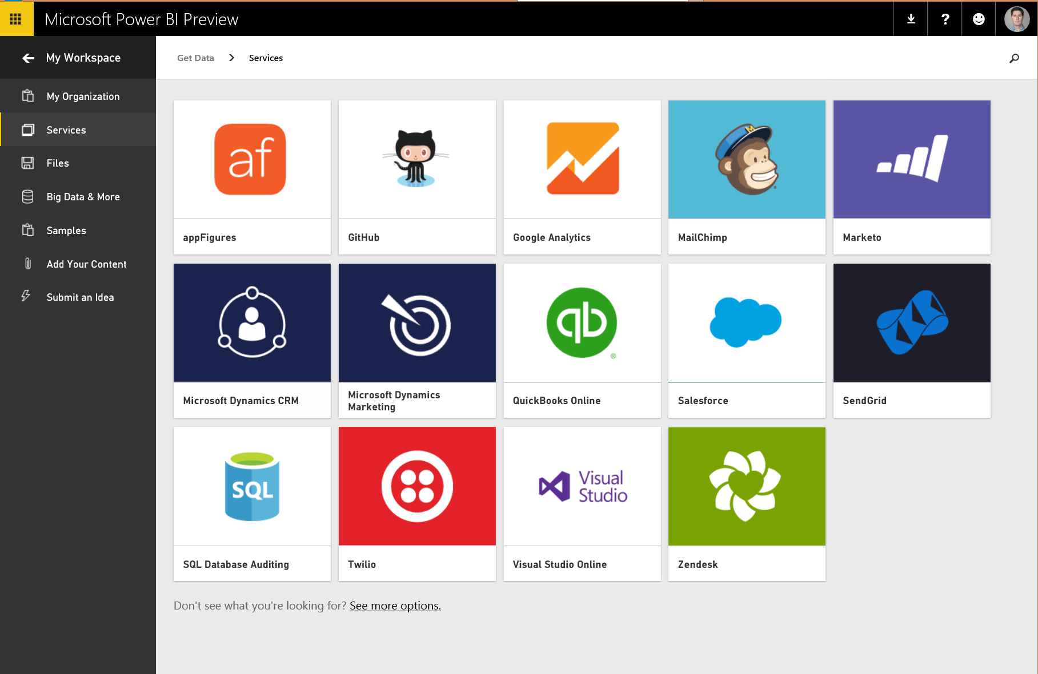
















Power BI Content Packs
TODAY
Prebuilt Power BI experience for your service
Dynamics Marketing
COMING SOON
Azure Mobile Engagement
Notes:
Power BI makes it easy for users to visualize and analyze their data in minutes, providing pre-built solutions for popular services as part of the Power BI experience. A subscriber to a supported service can quickly connect to their account from Power BI and see their data through live dashboards and interactive reports that have been pre-built for them. We have released content packs for 16 popular services such as Salesforce.com, Marketo, and Quickbooks Online. We have announced that over the coming months we will extend this support to include content packs and integrations for Adobe Analytics, comScore, Azure Mobile Engagement, Sage, SpaceCurve, tyGraph, CircuitID, Sumo Logic, SQL Sentry, Zuora, Planview, Insightly, Troux, Inkling, and others.
Power BI has hundreds of solutions available from Microsoft and from our partner community.

Slide 26




Power BI overview
No matter what industry, or what role, Power BI is relevant
Business user
Business analyst
BI professional
Software developer
Notes:
No matter what industry or what role, Power BI is relevant.
For the business user it could be as simple as accessing software as a service solutions.
These content packs enable quick access to reports and dashboards.
For the business analyst, working with a tool like Power BI Desktop.
They can import, shape, cleanse, integrate and model data and then build compelling reports and then publish these as solutions to produce dashboards and to share.
They can also consider creating content packs to share insights within the organization.
For the BI professional, perhaps working in the IT team, they can connect to live Azure data sources.
They can connect to on-premises Analysis Services databases and empower colleagues to create their own reports.
For the developer, there are programmatic scenarios including the integration of applications with Power BI.
The creation and delivery of real-time dashboards and the development of custom visuals to extend beyond the out of the box visualizations available with Power BI.
This slide can be used to categorize the Power BI features into different roles.
During this course, different topics will be relevant to different roles – so it is good to define these early on.

Slide 27
Power BI overview
No matter what industry, or what role, Power BI is relevant
Business user
Import data from SaaS sources
Work with dashboards and reports
Ask natural language questions
Discover quick insights from data
Notes:
No matter what industry or what role, Power BI is relevant.
For the business user it could be as simple as accessing software as a service solutions.
These content packs enable quick access to reports and dashboards.
For the business analyst, working with a tool like Power BI Desktop.
They can import, shape, cleanse, integrate and model data and then build compelling reports and then publish these as solutions to produce dashboards and to share.
They can also consider creating content packs to share insights within the organization.
For the BI professional, perhaps working in the IT team, they can connect to live Azure data sources.
They can connect to on-premises Analysis Services databases and empower colleagues to create their own reports.
For the developer, there are programmatic scenarios including the integration of applications with Power BI.
The creation and delivery of real-time dashboards and the development of custom visuals to extend beyond the out of the box visualizations available with Power BI.
This slide can be used to categorize the Power BI features into different roles.
During this course, different topics will be relevant to different roles – so it is good to define these early on.

Slide 28
Power BI overview
No matter what industry, or what role, Power BI is relevant
Business analyst
Import, reshape, integrate and model data
Enrich data with calculations
Create compelling reports and visualizations
Publish reports to the Power BI service
Publish content packs to share insights within the organization
Notes:
No matter what industry or what role, Power BI is relevant.
For the business user it could be as simple as accessing software as a service solutions.
These content packs enable quick access to reports and dashboards.
For the business analyst, working with a tool like Power BI Desktop.
They can import, shape, cleanse, integrate and model data and then build compelling reports and then publish these as solutions to produce dashboards and to share.
They can also consider creating content packs to share insights within the organization.
For the BI professional, perhaps working in the IT team, they can connect to live Azure data sources.
They can connect to on-premises Analysis Services databases and empower colleagues to create their own reports.
For the developer, there are programmatic scenarios including the integration of applications with Power BI.
The creation and delivery of real-time dashboards and the development of custom visuals to extend beyond the out of the box visualizations available with Power BI.
This slide can be used to categorize the Power BI features into different roles.
During this course, different topics will be relevant to different roles – so it is good to define these early on.

Slide 29
Power BI overview
No matter what industry, or what role, Power BI is relevant
BI professional
Connect to live Azure data services
Connect to on-premises Analysis Services databases
Educate and empower the business to create their own reports
Notes:
No matter what industry or what role, Power BI is relevant.
For the business user it could be as simple as accessing software as a service solutions.
These content packs enable quick access to reports and dashboards.
For the business analyst, working with a tool like Power BI Desktop.
They can import, shape, cleanse, integrate and model data and then build compelling reports and then publish these as solutions to produce dashboards and to share.
They can also consider creating content packs to share insights within the organization.
For the BI professional, perhaps working in the IT team, they can connect to live Azure data sources.
They can connect to on-premises Analysis Services databases and empower colleagues to create their own reports.
For the developer, there are programmatic scenarios including the integration of applications with Power BI.
The creation and delivery of real-time dashboards and the development of custom visuals to extend beyond the out of the box visualizations available with Power BI.
This slide can be used to categorize the Power BI features into different roles.
During this course, different topics will be relevant to different roles – so it is good to define these early on.

Slide 30
Power BI overview
No matter what industry, or what role, Power BI is relevant
Software developer
Integrate applications with Power BI
Create real-time dashboards
Develop custom visuals
Notes:
No matter what industry or what role, Power BI is relevant.
For the business user it could be as simple as accessing software as a service solutions.
These content packs enable quick access to reports and dashboards.
For the business analyst, working with a tool like Power BI Desktop.
They can import, shape, cleanse, integrate and model data and then build compelling reports and then publish these as solutions to produce dashboards and to share.
They can also consider creating content packs to share insights within the organization.
For the BI professional, perhaps working in the IT team, they can connect to live Azure data sources.
They can connect to on-premises Analysis Services databases and empower colleagues to create their own reports.
For the developer, there are programmatic scenarios including the integration of applications with Power BI.
The creation and delivery of real-time dashboards and the development of custom visuals to extend beyond the out of the box visualizations available with Power BI.
This slide can be used to categorize the Power BI features into different roles.
During this course, different topics will be relevant to different roles – so it is good to define these early on.

Slide 31
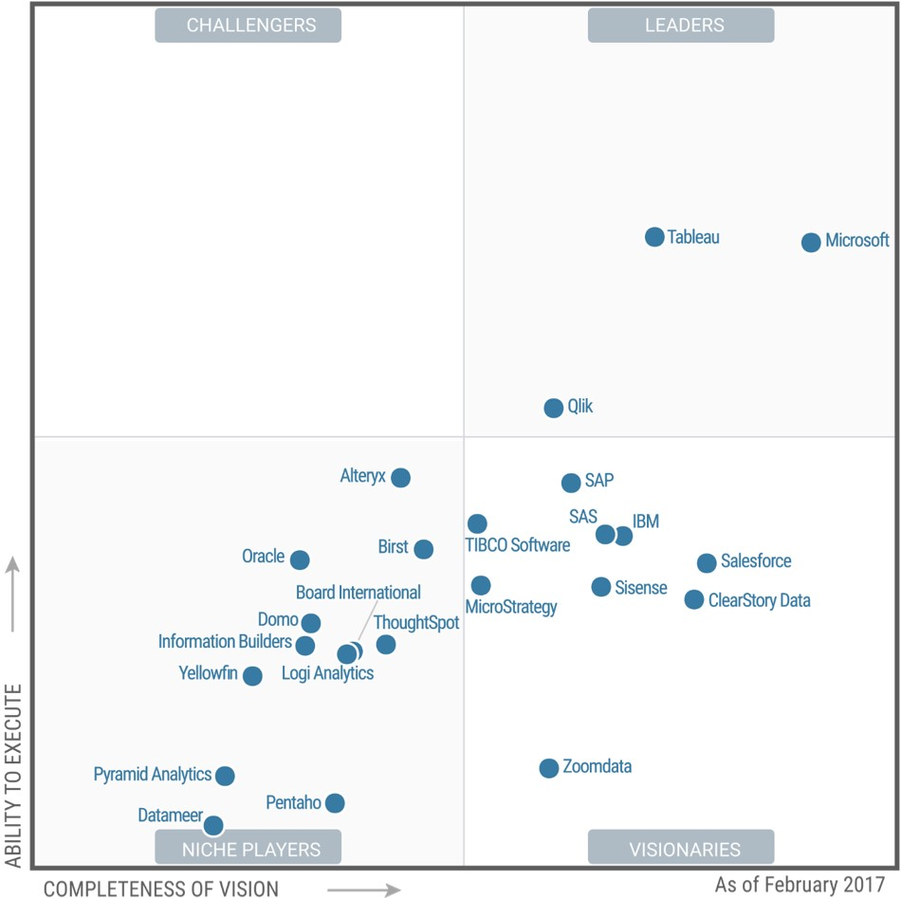

FEBRUARY 2017
A Leader in the Magic Quadrant for BI & Analytics*
*Gartner “Magic Quadrant for Business Intelligence and Analytics Platforms,” by Rita L. Sallam, Cindi Howson, Carlie J. Idoine, Thomas W. Oestreich, James Laurence Richardson, and Joao Tapadinhas February 16, 2017
This graphic was published by Gartner, Inc. as part of a larger research document and should be evaluated in the context of the entire document. The Gartner document is available upon request from Microsoft. Gartner does not endorse any vendor, product or service depicted in its research publications, and does not advise technology users to select only those vendors with the highest ratings or other designation. Gartner research publications consist of the opinions of Gartner's research organization and should not be construed as statements of fact. Gartner disclaims all warranties, expressed or implied, with respect to this research, including any warranties of merchantability or fitness for a particular purpose.
Notes:
https://powerbi.microsoft.com/en-us/blog/gartner-positions-microsoft-as-a-leader-in-bi-and-analytics-platforms-for-ten-consecutive-years/
Gartner has recognized our vision and execution for the tenth consecutive year, positioning Microsoft as a Leader in the Magic Quadrant for Business Intelligence and Analytics Platforms.* Also, for second year in row, Microsoft is placed furthest in vision within the Leaders quadrant.

Slide 32
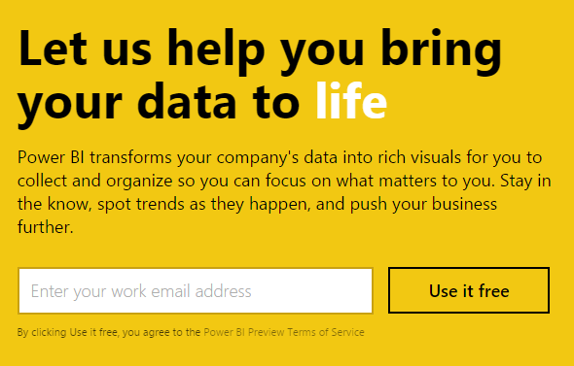
Signing up for Power BI
Sign up can be achieved for free, and within seconds
Power BI works only with an organizational account, associated with a work or school email address
Encourage customers to trial Power BI for free, and to realize the benefits of Power BI Pro features
Note: Pricing and licensing will be described in the final module
Notes:
Users can easily and quickly get started with Power BI today.
Sign up can be achieved for free and within seconds.
Note the Power BI works only with an organizational account associated with the work or school email address.
And we'd encourage you to encourage your customers to trial Power BI for free and to realize for 60 days the ability to work with the Power BI Pro features.
In the summary of this training series I'll be wrapping up by talking about licensing and reviewing the features that are supported only with the Power BI pro license.
Key message:
Get started quickly with the Power BI service (powerbi.com) for faster decision-making by displaying all of your data in one place
Talking points:
As discussed earlier, you can get started quickly with pre-built content packs for popular SaaS solutions
The primary capability of Power BI is that it empowers you to create and customize live dashboards – dashboards that include visualizations from multiple data sources
That is, dashboards can show different types of data from a variety of sources, and can use a range of unique visualizations
If applicable, you can track status in real-time thanks to support for real-time data sources
You have full control over your dashboards – pin any visualization from any report to any dashboard
Click through visualizations to access their underlying reports to discover more data and new insights

Slide 33
Exploring Power BI
01A
Notes:
In this short demonstration, I commence by signing in into the PowerBI servers.
And then let me point out that in my workspace there are presently no data sets reports or dashboards.
So, I'm going to get data from a service and we'll find that there is a content pack available for Bing.
I simply click Get and then I type in keywords.
Let's take a look at the search term of Power BI, I click Add.
Notice now in the left-hand side, I have the Bing Power BI dashboard.
Let's take a look at this dashboard in full screen mode.
And we can see details like Volume, Volume change from last week and details about where counts of requests are coming from.
So, in a matter of seconds, there in less than a minute.
I've signed in, connected to the Bing content pack and produced the dashboard to show details about Power BI searches.
Power BI has being designed to make it easy to get to data.
Here I am clicking on Get Data.
And we can see options to import content packs from software as a service services.
Internally publish content packs from within the organization.
The ability to upload files within Power BI Desktops, CSV or even Excel work books containing data models.
And the ability to connect live to database be it cloud databases, or even analysis services on-premises.
I've gone ahead and pre-produced a dashboard in fact a later demonstration will show how this dashboard will be laid out.
But eventually this dash board makes it very simple for people to stay focused on key metrics and data.
There's the ability also to ask questions.
Show me sales by country And there we see a visual in response, in CY.
There we have the years, calendar year 2015.
And now that I have that response, if I'd like to return to it.
Well, I'll probably likely pin that back to the dashboard, and then we'd see this would become a tile.
As we see here.
Dashboards are a great way of bringing together data from multiple reports and data sets.
And there's also the easy ability for those dashboards to be shared.
Up here in the top right column or corner I can click Share and then I can share this with other users within the organization.
And potentially also with those outside of the organization.

Slide 34
Key takeaways
Power BI is a cloud-based business analytics service, delivering end user BI
Power BI delivers numerous benefits and differentiators
Pre-built content packs
Real-time dashboard updates
Live connections to on-premises and cloud data sources
Intuitive data exploration by using natural language query
Integration with familiar Microsoft products and services
Fast deployment, hybrid configuration, secure, and integrated with existing IT systems
Microsoft is placed furthest in vision within the BI and Analytics Platform Leaders quadrant
Notes:
The key take-aways in this module then.
Power BI is a cloud-based business analytic service, delivering end user BI.
Power BI delivers numerous benefits and differentiators, including pre-built content packs, real-time dashboard updates, live connections to on-premises and cloud data sources.
Intuitive data exploration by using natural language query, integration with familiar Microsoft products and services.
And fast deployment, hybrid configuration, secure and integrated with your existing IT deployments.
Lastly, Microsoft is placed furthest in vision within the BI and Analytics Platform Leaders quadrant.

Slide 35
Resources
Power BI site
http://powerbi.microsoft.com
Power BI documentation
http://support.powerbi.com/
Power BI community
http://community.powerbi.com/
Power BI blog
http://blogs.msdn.com/b/powerbi/
Tip: Power BI is evolving at a rapid rate. One of the best ways to keep pace with updates is to subscribe to the Power BI blog.
Notes:
To support your continued learning, you may find these relevant resources useful.
Specifically, you'll find that Power BI is an evolving service and so therefore we'd encourage you to subscribe to the Power BI blog.
With the rapid change that takes place with Power BI, this is one of the best ways to keep pace with updates.

Slide 36
Resources
Continued
Microsoft Cloud and Enterprise Partner Resources
http://aka.ms/powerbipartners
Includes up-to-date resources:
Customer-ready materials
Customer evidence
Training and labs
Demos
“What to do next”
Gartner positions Microsoft as a leader in BI and Analytics Platforms
https://powerbi.microsoft.com/en-us/blog/gartner-positions-microsoft-as-a-leader-in-bi-and-analytics-platforms-for-ten-consecutive-years/
Notes:
We'd also recommend that the Microsoft Cloud and Enterprise Partner Resources are at excellent location to find resources including Customer ready materials, customer evidence, training and labs, demos, and what to do next resources.
Lastly, if you'd like to read more about Microsoft's positioning in the Gartner quadrant.
You'll find additional details and notifications at this link.

Slide 37


https://www.youtube.com/watch?v=yfbXtQq7MVY

Slide 38
Questions?
Notes:
Use this slide to ask any remaining questions before moving to the next module.

Slide 39
02 Creating Power BI Desktop solutions
Introducing Power BI Desktop
Creating queries
Configuring relationships
Enhancing the model
Securing the model
Designing reports
Publishing to Power BI
Describing additional capabilities
Notes:
Introduce the module title and topics.
It is recommended that you become fully familiar with the module content by researching the topics at the Power BI knowledgebase: https://support.powerbi.com/knowledgebase - many links are provided in the presenter notes.
Data transformation capabilities of the Power BI Desktop and actually that’s probably where you’ll spend most of your
time when you are doing BI projects

Slide 40
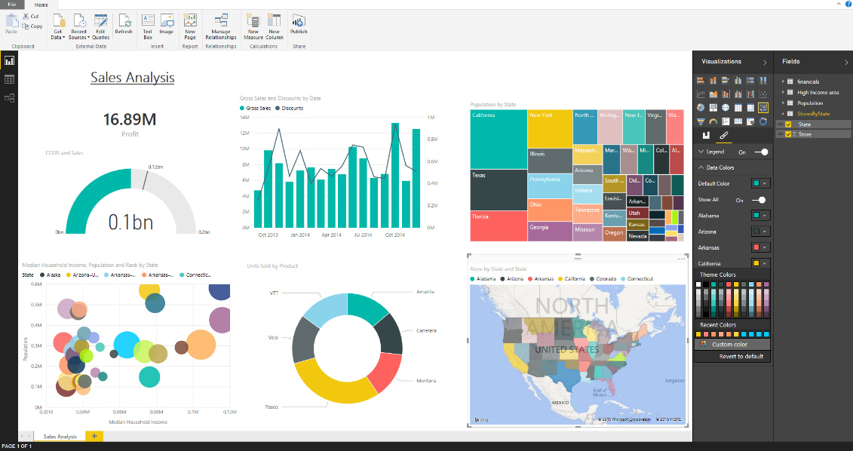
Introducing Power BI Desktop
Power BI Desktop is a visual data exploration and reporting tool
A freely downloadable 32- or 64-bit desktop application optimized for use with the Power BI service
Integrates proven Microsoft technologies
Excel add-ins: Power Query, Power Pivot and Power View
Enables multiple ways to transform schema and data
Updated (at least) on a monthly basis
Notes:
Power BI Knowledgebase: https://support.powerbi.com/knowledgebase/topics/68530-power-bi-desktop
Powerful visual data exploration tool and reporting tool
Let’s you connect to different data sources
Cleanse that data and convert it into format more suitable for analysis
Enrich your model and finally do visualization on top of that
It’s updated on monthly basis
Specifically around transformations,
we’ll focus on things like splitting and merging columns, changing the data types,
working with dates, and doing things to help model that data in different
ways and create relationships between it so that it’s easier
to do that analysis.

Slide 41
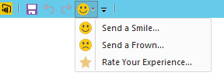
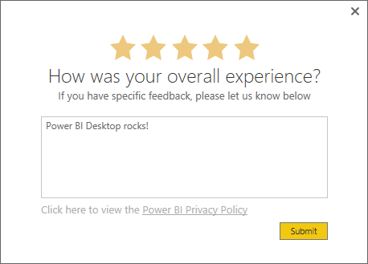
Introducing Power BI Desktop
Providing feedback
Feedback can be provided:
Send a Smile to convey satisfaction with the tool, or a specific feature
Send a Frown to convey the opposite
Both options open a mail message, with the opposition to include a screenshot and/or formulas
Specific feedback can be sent directly by rating the experience
Notes:
You can share your feedback with the product team on the tool, you can send smily or frown, or rate the overall experience and also provide specific feedback.

Slide 42
Developing a simple Power BI Desktop solution
05A
Notes:
Launch PBI Desktop Designer
Connect to Azure SQL DB, AdventureWorksDW
Direct query (store definition, queries at report time sent to underlying data source) vs Import to efficiently load and compress the data
Edit vs Load the entire table
Load FactResellerSales
Sigma = Numeric, aggregated or summarized within the report
Sales Amount, by default chart, aggregated total of 80m$
Drag Order date for sales by year
Enable drill down and drill to 2013
Drill to entire next level
This concludes a simple demo, in next demo we will remove this visual, enrich model and show more advanced application of using Power BI desktop

Slide 43
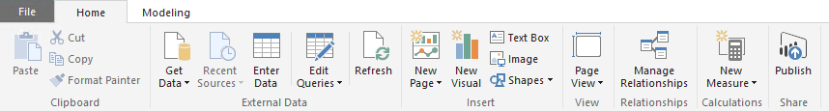
Introducing Power BI Desktop
User experience: Getting data
A query is defined by “getting data”
Source types include File, Database, Azure, Online Services and Other
Data can be simply and quickly loaded “as is”
Typically: Select type ► Define connection ► Authenticate ► Load
Optionally, the Query Editor can be used to transform queries
Notes:
It all begins by connecting to, and retrieving, data.
Power BI knowledgebase: https://support.powerbi.com/knowledgebase/articles/471635-connect-to-data-in-power-bi-designer
Sources can include file sources, databases, online sources and others. Data can be simply loaded as is, or you can also apply transformation on the data.

Slide 44
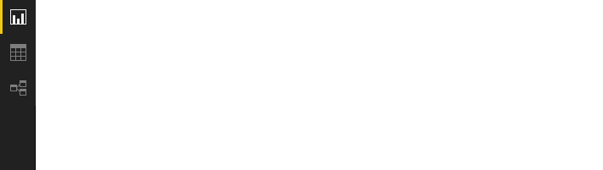
Introducing Power BI Desktop
User experience: Three views
Report view
Data view
Relationships view
Notes:
The three views provide alternate user experiences to work with their model.
There are three main views, the Report view, Data View and Relationships View.

Slide 45
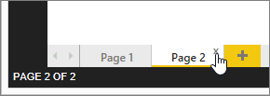
Introducing Power BI Desktop
User experience: Report view
Work in Report View to create any number of report pages with visualizations
It provides a very similar design experience as the Power BI service
A report will have at a blank page to start, and any number of pages can be added
Pages appear, and can be managed, in the navigator pane
Notes:
Power BI knowledge base: https://support.powerbi.com/knowledgebase/articles/461283-report-view-in-power-bi-designer
Report view you work with pages of reports. A report will have at a blank page to start, and any number of pages can be added. Pages appear in the navigator pane.

Slide 46
Introducing Power BI Desktop
User experience: Report view: Continued
The intent of the application is to land the user on the report canvas as quickly as possible
Built-in intelligence will often infer relationships, and detect data types and categories
Evidence suggests that most schemas are relatively simple, and so the optimized path is: Load data ► Visualize
Many model transformations can be applied while working in Report View
Change data types, formats, calculation formulas
Rename fields
Sort columns
Manage relationships
Note: The versatility of Report View, and the immediate visualization of model transformations, is a strong competitive advantage over many other data analysis and reporting products
Notes:
Application Intent to get you to report view as quickly as possible
To enable this, built-in intelligence infers, data types, relationships and categories from data source
You can apply transformation operations as needed from the report view.
This design aspect of getting you to visualizations is strong advantage over competition.

Slide 47
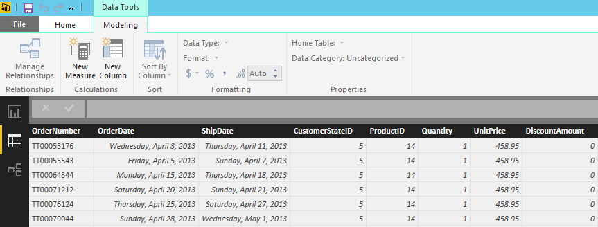
Introducing Power BI Desktop
User experience: Data view
Work in Data View to inspect, explore, and understand data in the model
It is a different experience from how you view tables, columns and data in Query Editor
This is a view of the data after it has been loaded into the model
Notes:
Power BI knowledgebase: https://support.powerbi.com/knowledgebase/articles/663202-data-view-in-power-bi-desktop
in Data View we inspect, explore, and understand data in the model. This is a view of the data after it has been loaded into the model

Slide 48
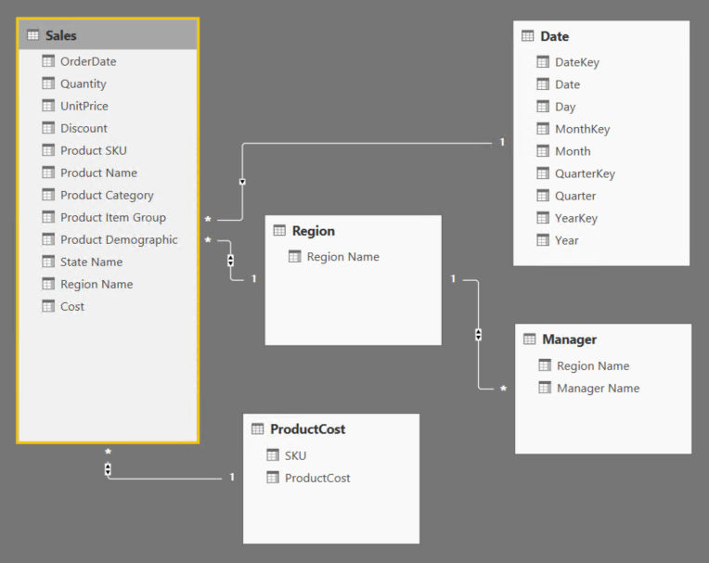
Introducing Power BI Desktop
User experience: Relationships view
Work in Relationships View to view all tables, columns, measures and relationships in the model
Notes:
Power BI knowledgebase: https://support.powerbi.com/knowledgebase/articles/663229-relationship-view-in-power-bi-desktop
view all tables, columns, measures and relationships in the model

Slide 49
Introducing Power BI Desktop
Complex schemas: Development methodology
In contrast to the simple and quick “get then visualize” approach, more complex schemas may follow this methodology:
Create queries and use the Query Editor to filter, cleanse and reshape data
Configure/refine relationships to establish the foundations of a model
Enrich the model with calculation logic and formatting
Design interactive reports with a broad range of modern data visualizations
Publish solutions directly to the Power BI service
Create queries
Configure relationships
Enhance the model
Design reports
Publish to Power BI

Slide 50
Creating queries
Create queries
Configure relationships
Enhance the model
Design reports
Publish to Power BI
Queries can be edited before loading into the model
Once created, each query:
Is referenced by a unique name
Defines query steps by using the language “M”
Most query step logic does not require writing formulas
Advanced logic can be written, and even exposed as functions
Is used to load data into a model table
Notes:
https://powerbi.microsoft.com/en-us/documentation/powerbi-desktop-data-sources/
Most scenarios don’t require writing formulas as there is comprehensive functionality available through context menu and the ribbon. However for more advanced scenarios, you can go beyond and write advanced logics and function in “M”

Slide 51
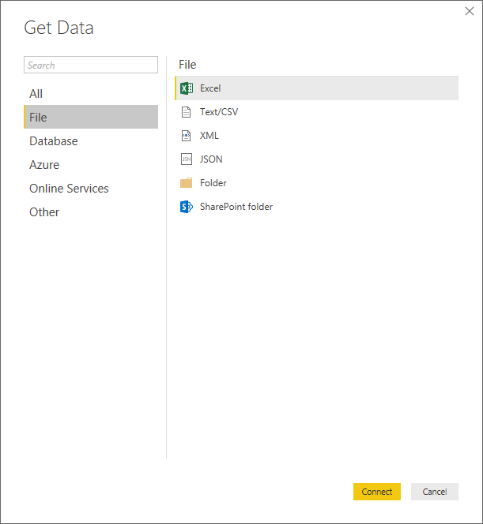
Creating queries
Source types: File
Notes:
Queries can be sourced from different types of data.
File, Database, Azure, Online Services and Other.
And we see here that the File sources supported include Excel, CSV, XML, Text, JSON, Folder for the file system and also SharePoint folder.

Slide 52
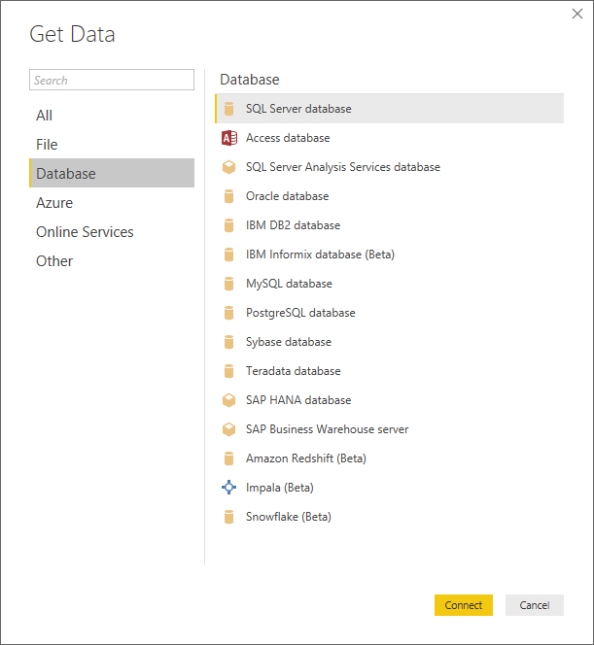
Creating queries
Source types: Database
The SQL Server Analysis Services Database connector enables connecting to Azure Analysis Services
Notes:
https://powerbi.microsoft.com/en-us/blog/introducing-azure-analysis-services/
Database sources include SQL Server, Access, Analysis Services, Oracle, IBM, and many other popular database products.

Slide 53
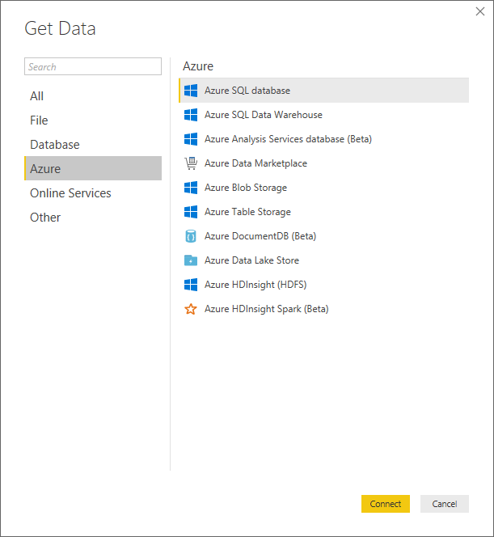
Creating queries
Source types: Azure
Notes:
Azure Services include Azure SQL Database and Azure SQL Data Warehouse and many other Azure services.
And Online Services, this is a growing list of software as a service providers.
And so we find that there are literally dozens, and these are growing week by week.

Slide 54
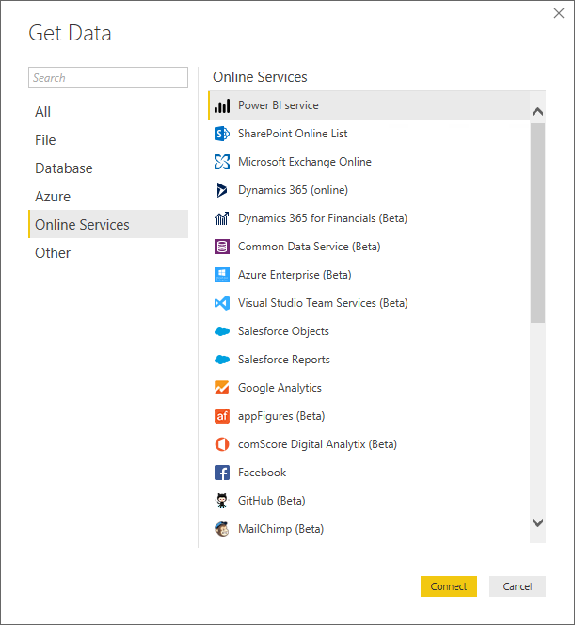
Creating queries
Source types: Online Services
The list also includes:
Marketo (Beta)
Mixpanel (Beta)
Planview Enterprise (Beta)
ProjectPlace (Beta)
Quickbooks Online (Beta)
Smartsheet
SparkPost (Beta)
SQL Sentry (Beta)
Stripe (Beta)
SweetIQ (Beta)
Troux (Beta)
Twilio (Beta)
tyGraph (Beta)
Webtrends (Beta)
Zendesk (Beta)
* As at April, 2017
And the list is growing!
Notes:
And Online Services, this is a growing list of software as a service providers.
And so we find that there are literally dozens, and these are growing week by week.

Slide 55
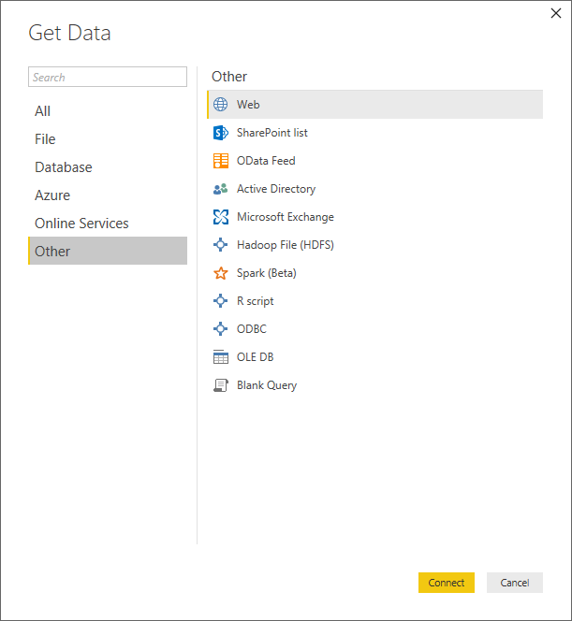
Creating queries
Source types: Other
Note: The following are not supported for on-premises refresh
Hadoop File (HDFS)
Microsoft Exchange
Notes:
On to the Other section, there are Web sources, SharePoint List, OData Feed, Hadoop File, Active Directory, Microsoft Exchange, ODBC, R Script, Spark, and a Blank Query for writing ScriptLogic with M.

Slide 56
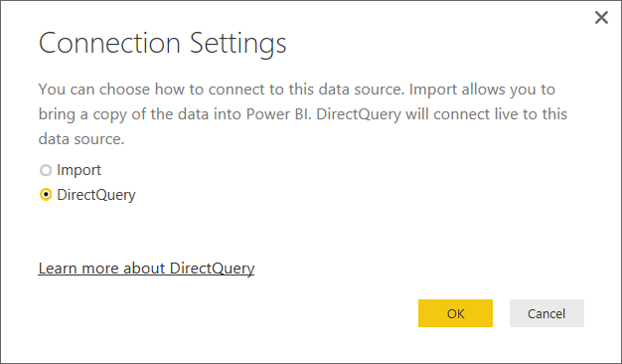
Creating queries
DirectQuery mode
Connections made to supported data sources can connect directly by using DirectQuery:
SQL Server
Azure SQL Database
Azure SQL Data Warehouse
SAP HANA
Oracle Database
Teradata Database
Amazon Redshift (Preview)
Impala (Preview)
Snowflake (Preview)
Notes:
https://powerbi.microsoft.com/en-us/documentation/powerbi-desktop-use-directquery/
DirectQuery mode enables direct queries to be sent from the Power BI desktop file to the underlying data source.
And this is in contrast to data being loaded, imported in to the model.
Not all data sources are supported for DirectQuery.
Those that are include SQL Server, Azure SQL Database, Azure SQL Data Warehouse, SAP HANA, Oracle Database, Teradata Database and Amazon Redshift currently in preview.

Slide 57
Creating queries
DirectQuery mode: Continued
Benefits:
Allows building visualizations over very large datasets
Reports always use current data
Notes:
When the Power BI desktop file is published to the service, credentials will need to be supplied to allow connectivity to these DirectQuery connections.
If it's an on-premises data source, then the On-Premises Data Gateway must be installed, and the data sources must be registered to establish the data connection.
The benefits of using this mode include, the ability to build visualizations over very large data sets that would be impractical or impossible to import.
And to ensure that reports are always delivering up to date data.

Slide 58
Creating queries
DirectyQuery mode: Continued
Limitations:
All tables must come from a single database
The Query Editor query cannot be overly complex
DAX formula are restricted to a subset of the DAX functions
The data type of a column cannot be changed
Q&A is not supported
Quick Insights are not available
Notes:
There are some limitations when working in DirectQuery mode.
All tables must come from a single database.
The Query Editor query cannot be overly complex.
Ultimately, the query that you define must translate to the native query language of the data source and not all query expressions can translate.
DAX formula are restricted to a subset of DAX functions for a similar reason.
Relationship filtering is limited to a single direction, rather than both directions.
Although in preview there is a feature that allows you to trial this.
The data type of the column cannot be changed.
Q&A will not be supported in the Power BI's service dashboards, and likewise, Quick Insights will not be available.

Slide 59
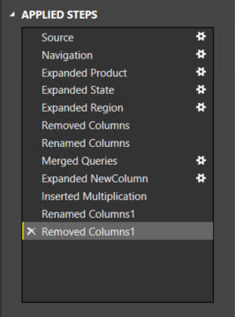
Creating queries
Defining query steps
The Query Editor can be used to filter, cleanse and reshape data into the desired result
Steps can easily be produced by applying column filters, and by using the commands available from the ribbon, or the query and column context menus
It is possible to select a step and preview the data at that step
Steps can be removed – but take care not to remove a step that downstream steps depend on
Step formulas can be viewed or edited in the formula bar
Notes:
When defining your query, you use the Query Editor to filter, cleanse, reshape the data to the desired result.
Steps can easily be produced by applying column filters and by using the commands available from the ribbon, and the query and column context menus.
It's a very flexible environment to work within.
It's a what you see is what you get.
And ultimately you build up a list of steps that produce the data set that you want loaded into the model.

Slide 60
Creating queries
Defining query steps: Commands
Numerous commands are available on the Query Editor ribbons and context menus to:
Manage columns
Reduce rows, including removing errors
Transform
Split
Add columns, by using formulas
As the editor experience is WYSIWYG, users can easily experiment and rollback changes
Notes:
Numerous commands are available on the Query Editor ribbons and context menus.
These allow you to manage columns, rename them, change data types, reduce rows by filtering or by identifying errors and removing those rows, transforming, splitting, adding columns based on n formulas.

Slide 61
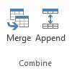
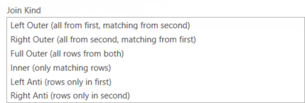
Creating queries
Defining query steps: Combining queries
New queries can be created by:
Merging two queries (joining on a common column)
Appending two queries (union)
Merge join options include:
Notes:
It's also possible to combine queries.
This could involve merging two queries based on a common column or appending two queries as in a union.

Slide 62
Configuring relationships
Create queries
Configure relationships
Enhance the model
Design reports
Publish to Power BI
Relationships enable filters on one table to appropriately propagate filter to other tables
They can be defined between any two tables, regardless of their data connection or source type
However, they must be based on single columns with matching data types
Notes:
Having loaded queries into the model, at this stage they are then referred to as tables and relationships will enable filter context to flow between tables. So it's important to point out the relationships that you see in Relationship view are not foreign key constraints as maybe interpreted from a relational database diagram. They are in fact, pathways by which filter context from one table flows to another. For example, filtering on calendar year 2016 in a date table, we'll pass that context through the relationship to ensure that only the rows for sales that have taken place in that calendar year would be aggregated.
Relationships can be defined between any two tables regardless of the data connection or source type.
However, they must be single column relationships with matching data types.
And there's no support for self-referencing relationships to generate parent-child hierarchies.

Slide 63

Configuring relationships
Advanced options: Continued
Configure relationship advanced options to set:
Cardinality
Cross filter direction
The Both option enables many-to-many analysis
Active/inactive
Tip: All options can be interpreted from symbols used in the relationship diagram
Notes:
You can also configure Cardinality, Cross filter direction.
And the Cardinality would allow you to support one to many, or many to one, or now one to one relationships between tables.
The Cross filter direction determines which direction the filter context flows.
And by configuring it to both, you end up with some interesting arrangements, whereby filtering the sales or and filtering the date table can produce the desired results.

Slide 64
Enhancing the model
Create queries
Configure relationships
Enhance the model
Design reports
Publish to Power BI
Model tables can be extended with hierarchies, calculations, and may be hidden (i.e. not available for reporting)
Model column properties can be set:
Data type
Format
Categorization
Spatial types, or web URLs
Sort order, based on another column from the same table
Default summarization (numeric, text and date columns)
Visibility
Notes:
Next, enhancing the model.
Model tables can be extended with hierarchies, calculations, and these may also be hidden.
The model column properties can be set with their data type property, how to format, categorization, especially for spatial types for mapping.
Whether the values in a column should sort based on another column values.
For numeric columns, the default summarization, should it sum, should it average, min-max, and should it be visible?

Slide 65


Enhancing the model
Hierarchies
Hierarchies can be added to a table, enabling navigation between columns (in the one-to-many direction)
Notes:
Hierarchies can be added to a table enabling navigation between columns in the one-to-many direction.
And here we see an example of year, quarter and month columns assembled into the calendar hierarchy.

Slide 66
Enhancing the model
Calculations
There are three different types of calculations, and each are defined by using DAX:
Calculated columns
Calculated tables
Measures
DAX = Data Analysis EXpressions (DAX), consisting of:
Excel functions (~80 functions)
Table functions
Aggregate functions
Relationship navigation functions
Context modification functions
Time Intelligence functions
Note: DAX theory is not covered in this training course
Notes:
Adding calculations to the model can be achieved with three different techniques.
Calculated columns, calculated tables, and measures.
All calculation to define by using DAX, which stands for Data Analysis EXpressions.
This expression language has been based largely on Excel functions.
Although it is been extended to support modelling capabilities and therefore it has table functions, aggregate functions, relationship navigation functions, context modification functions and time intelligence functions.
This is an involved topic and so this training course will not go through the theory of DAX.

Slide 67
Enhancing the model
Calculations: Calculated columns
Define Calculated Columns to add new columns to tables
Column values for each row are materialized and stored in the model
If possible, to reduce the model size, avoid creating them
Column values are recalculated when:
The table is refreshed
Formula dependencies are refreshed
Notes:
We'll talk about the application of it though and so Calculated Columns, defined by using DAX, simply adds new columns to tables.
It's important to note that these increase the size of the model, and column values are recalculated when the table is refreshed or formula dependencies are refreshed.

Slide 68
Enhancing the model
Calculations: Calculated tables
Define Calculated Tables to add new tables to the model, based on existing data from other tables
Calculated tables are generally best for intermediate calculations of data stored in the model, rather than calculated on the fly
Calculated tables appear in Relationship View, and relationships can be defined with other tables
If possible, to reduce the model size, avoid creating them
Calculated tables are recalculated in the same circumstances as calculated columns
Note: This is an advanced design concept
Notes:
Power BI knowledgebase: https://support.powerbi.com/knowledgebase/articles/741510-calculated-tables-in-power-bi-desktop
Calculated tables allow defining entire tables in the model based on a DAX expression that returns a table.

Slide 69
Enhancing the model
Calculations: Measures
Define Measures to add aggregation logic to the model
Values are not materialized in the model
Formulas are evaluated at query time
Common aggregate functions:
SUM
COUNT, DISTINCTCOUNT, COUNTROWS
AVERAGE, MEDIAN
MIN, MAX
Note: Summarizable columns are aggregated by reports—so defining measures is not necessary for simple aggregation requirements
Notes:
And measures, define aggregation logic in the model.
And in contrast to calculated columns, the values for measures are not materialized or stored.
They're computed and evaluated at query time.
Common aggregate functions used by measures include sum, count, distinct count, average, minimum and maximum.

Slide 70

Enhancing the model
Tuning the model
The model design can be tuned to improve its usefulness and Q&A response accuracy
Set appropriate column data types, formats and categorization
Ensure relationships are configured
Ensure table and columns are visible/hidden
Ensure table, column and measure names are unique and concise
Define synonyms (in Relationships view) for tables, columns, and calculations
Notes:
Tuning the model is important to improve the usefulness of Q&A.
You can do this by setting appropriate column data types, formats and categorization.
Ensuring that relationships are correctly configured, ensuring the tables and columns are visible or perhaps hidden if you don't want them to be candidates for using Q&A.
Also ensuring that tables, columns and measure names are unique and concise.
And it's also possible to define synonyms in Relationships view to provide alternate names that your users may refer to for tables, columns, and calculations.

Slide 71
Securing the model
Row-level security
It is possible to restrict data access to datasets for given users
Filters restrict data at the row level, and are assigned to roles
Users are also assigned to roles
Roles are defined in Power BI Desktop
DAX expressions are used to filter tables, and can use the USERNAME() function to retrieve the current user name
Within Power BI Desktop, USERNAME() will return a user in the format of DOMAIN\User
Within the Power BI service, USERNAME() will return the user's User Principal Name (UPN)—looks similar to an email address
Users are assigned in the Power BI service
Notes:
https://powerbi.microsoft.com/en-us/documentation/powerbi-admin-rls/
It is possible to secure the model by restricting data access to the data set for given users.
Filters can be used to restrict data at row level and are assigned to roles that you define within the Power BI Desktop file.
Once published, it is possible then to assign users to these roles.

Slide 72

Designing reports
Create queries
Configure relationships
Enhance the model
Design reports
Publish to Power BI
Reports can be designed based on the visible model interface
The design experience is almost the same as is available in the Power BI online service
Text boxes, images and shapes can be added
Text boxes can contain hyperlinks
Notes:
And now to designing reports.
Reports can be designed based on the visible model interface.
And the design experience is almost identical to that available in the Power BI online service.
Text boxes, images and shapes can be added, and text boxes can contain hyperlinks.

Slide 73

Designing reports
Custom visuals
Custom visuals can be imported to extend beyond the out-of-the-box visualizations
A gallery of visuals created by the Power BI community is available at https://app.powerbi.com/visuals
Browse through the visuals or submit one of your own for others to use
The list of available visuals is growing each month
Custom visuals will render in the Power BI service
Note: The topic of custom visual development is covered later in this training course
Notes:
Custom visuals can be imported to extend beyond the out-of-the-box visualizations and we'll talk about custom visuals in the next module.

Slide 74

Designing reports
Custom visuals: Gallery (subset)
* And the list is growing!

Slide 75

Designing reports
Custom visuals: R-powered Visuals
A growing number of R-powered custom visuals are designed to deliver advanced analytics
Note:
The R engine must be installed on desktop
Specific R packages may need to be installed

Slide 76

Publishing to Power BI
Create queries
Configure relationships
Enhance the model
Design reports
Publish to Power BI
The Power BI Desktop file can be uploaded to the Power BI service, or published directly
Publish directly to your workspace or a group
Notes:
And now that the Power BI Desktop file is complete.
Queries have being loaded, appropriate relationships are defined, enhancements are made to the model with formatting, naming, calculations.
Reports have been designed on top of the model, and now as a single file, it can be published direct to the Power BI service.
You can publish direct by using a ribbon command, or you may upload the file from the Get-data in the Power BI service.
Do note that if you're overwriting an existing data set, if there are two or more data sets with the same name, you should remove one or rename one, otherwise it will overwrite.
Renaming columns or measures can break existing reports or dashboard tiles.
So if you are uploading a new version of the Power BI Desktop file, please be sure that it's compatible with existing reports and dashboards that have been created, maybe not just by you, but perhaps by other users.

Slide 77
Publishing to Power BI
Continued
Note, if overwriting an existing dataset:
If there are two or more datasets with the same name, remove one, or rename the Power BI Desktop file
Renaming columns or measures can break existing reports or dashboard tiles
If row-level security roles have been defined, once published, assign users to roles
Notes:
If row-level security roles have been defined, once published you will need to assign users to those roles.

Slide 78
Describing additional capabilities
Query parameters
Power BI template files
Running R scripts
Generating R visuals
Shape maps (Preview)

Slide 79
Describing additional capabilities
Query parameters
Query parameters allow users to easily make parts of their reports and data models depend on one or more parameter values
Parameters are defined in terms of:
Name, Description, Type, Allowed Values, Default and Current Value
Parameters are like other queries, and can be referenced from queries and loaded to the data model
Notes:
https://powerbi.microsoft.com/en-us/blog/deep-dive-into-query-parameters-and-power-bi-templates/
Let's then described some additional capabilities including query parameters, Power BI template files running R scripts, generating R visuals and shape maps, a new feature presently in preview.

Slide 80
Describing additional capabilities
Power BI template files
Templates allow users to export the definition of a Power BI Desktop report without including the actual data
Power BI Desktop file =
query definitions + data model + report + parameters (if any)
Users can easily instantiate a template by using Power BI Desktop, which will ask them for parameter values (if required) and create a new Power BI Desktop report (PBIX file) based upon the contents in the template file (PBIT file)
Notes:
https://powerbi.microsoft.com/en-us/blog/deep-dive-into-query-parameters-and-power-bi-templates/
Power BI template files allow users to export the definition of the Power BI Desktop report without including the actual data.
Users can then easily instantiate a template and then passing in parameter values, generate their own Power BI Desktop file.

Slide 81

Describing additional capabilities
Running R scripts
R scripts can be ran directly in Power BI Desktop, and resulting datasets imported into a Power BI Desktop data model
R must be installed on the local machine
Only data frames are imported
Columns typed as Complex and Vector are not imported
Can be refreshed with a gateway
Notes:
https://powerbi.microsoft.com/en-us/documentation/powerbi-desktop-r-scripts/
R Scripts can be run directly in Power BI Desktop and the resulting data sets imported into the data model.
This will involve that R is installed on the local machine, only data frames can be imported and columns, typed as Complex or Vector are not imported.
These can be refreshed with the gateway.

Slide 82

Describing additional capabilities
Generating R visuals
R visuals render from R script, accepting input fields
Benefits:
Leverage the voluminous and growing number of out-of-the-box plots available in R
Easily customize R visuals by developing the script
Combine advanced analytics in visuals
Interact with R visuals in Power BI Desktop (filter, and cross-filter are supported)
Notes:
https://powerbi.microsoft.com/en-us/documentation/powerbi-desktop-r-visuals/
And then R visuals render from R script, accepting input fields.
And the benefits are that you can leverage the voluminous and growing number of out-of-the-box plots available in R. Easily customize R visuals by developing the script, combine advanced analytics in visuals, and interact with R visuals in Power BI Desktop.

Slide 83

Describing additional capabilities
Shape maps (Preview)
Custom maps can be used provided they are in the TopoJSON format
Possibilities:
Geographical maps
Theater seat bookings
Supermarket store layouts
Notes:
https://powerbi.microsoft.com/en-us/documentation/powerbi-desktop-shape-map/

Slide 84

Enhancing a Power BI Desktop solution
05B
Notes:
Remove visual
Edit Query
Limit columns to Sales Amount, Order Date and DimReseller
DimReseller is link to values from Foreign Key Constraint
Bring BusinessType and DimGeography (which is another Relationship) from Dim Reseller
Get English Country Region Name from DimGeography
Rename Columns to friendly names, Close and apply
Rename Table to Reseller Sales
And also the tab to Reseller Sales
Commence the layout of report by adding AW logo and Reseller Sales Text
Add date Dimension using CalendarAuto() and Month and Year columns from text file
Define relationship with Date table and hide Order Date and Date columns
Add Date Slicer for interactive filtering and filter by CY2013 initially
Sales Amount Card with no zeroes and background blue
Add chart with Sales Amount vs Month. Sorting by text value and not chronological sequence of month
Hide the month Key
Apart from Sales By Month, do Sales by country and do per-capita analysis
Wikipedia List of Countries by Population in 2010: https://en.wikipedia.org/wiki/List_of_countries_by_population_in_2010
Table 0, Edit it and Rename it Country
Change ID to whole number and remove errors. Change Population to Whole number.
Define Relationship and Hide Country
Create measure for Sales Per Capita and format it to 3 decimal places
Add a card for it with Background color purple
And Add it to Barchart

Slide 85


Creating a Power BI Desktop solution
05A | 70 minutes
In this lab, you will create a Power BI Desktop solution to enable the reporting and analysis of US sales activity
Notes:
create a Power BI Desktop solution to enable the reporting and analysis of US sales activity. This will involve creating Power BI Desktop queries that source data from SQL Server, an Excel workbook and a CSV file.
You will then create two report pages consisting of various data visualizations, including a visual downloaded from the Power BI Visual Gallery.

Slide 86
Key takeaways
Continued
Power BI Desktop is a companion desktop application to Power BI
Power BI Desktop is a visual data exploration and reporting tool
The tool enables simple and quick visualization of data
For complex schemas, a development methodology can involve:
Creating queries
Configuring relationships
Enhancing the model with hierarchies and calculations
Designing reports, including the use of custom visuals
Publishing to Power BI
Notes:
Use this slide to describe the key takeaways of the module.
Power BI Desktop is the companion desktop application to Power BI.
It is a visual data exploration and reporting tool.
And this tool enables simple and quick visualization or support for more complex schemas.
And development methodology can include creating queries, configuring relationships, enhancing the model with calculations and hierarchies, designing reports using custom visuals, and then publishing to Power BI.
The user can choose to work in the way that makes most sense to them and their requirements.
Power BI Desktop File once published can have their data sources refreshed.

Slide 87
Key takeaways
The user can choose to work in the way that makes sense to them
Power BI Desktop files, once published, can have their data sources refreshed
Notes:
Use this slide to describe the key takeaways of the module.

Slide 88
Partner opportunities
Deliver high performance analysis and reporting
Store volumes of data with high compression (10x on average)
Or—use DirectQuery to “pass through” to supported data stores
Allows analysis and reporting over large volumes of data
Easily and efficiently integrate data from different data sources—organization, local and cloud
Source data from different data formats—relational, multidimensional, data feed, and file
Easily refresh data, when required
Notes:
Use this slide to inspire students with relevant the partner opportunities.

Slide 89
Partner opportunities
Continued
Encapsulate “single version of the truth” business rules with model calculations
Produce sophisticated calculation logic with DAX
Produce Time Intelligence formulas (i.e. YTD, etc.)
Design modern, interactive reports—even with custom visuals
Secure data differently for different users
Notes:
Use this slide to inspire students with relevant the partner opportunities.

Slide 90
Resources
Power BI Desktop knowledge base
https://support.powerbi.com/knowledgebase/topics/68530-power-bi-desktop
Tips and tricks for creating reports in Power BI Desktop
https://support.powerbi.com/knowledgebase/articles/464157-tips-and-tricks-for-creating-reports-in-power-bi-d
DAX Resource Center
“Your one stop shop for all things DAX”
http://social.technet.microsoft.com/wiki/contents/articles/1088.dax-resource-center.aspx
Notes:
To support your continued learning you may find these relevant resources useful.
Take note of the DAX Resource Center.
We didn't include any coverage on DAX but this is an excellent location to reference a number of quality resources available on DAX.

Slide 91
Resources
Office Store: Custom Visuals for Power BI
https://store.office.com/en-us/appshome.aspx?productgroup=PowerBI
Notes:
Use this slide to provide relevant resources to allow students to continue with deeper content.

Slide 92
Questions?
Notes:
Use this slide to ask any remaining questions before moving to the next module.

Slide 93
03 Working with the Power BI service
Introducing the Power BI online service
Creating and exploring reports
Assembling dashboards
Exploring with Q&A
Mobile applications
Sharing and collaborating
Describing additional capabilities
Tenant settings
Notes:
Introduce the module title and topics.
It is recommended that you become fully familiar with the module content by researching the topics at the Power BI knowledgebase: https://support.powerbi.com/knowledgebase - many links are provided in the presenter notes.

Slide 94
Introducing the Power BI online service
The Power BI online service offers a simple, intuitive experience for interacting with data
The service and features have been designed to:
Simplify engaging with data from heterogeneous sources
Fuel faster, more insightful business decisions
Deliver a rich, consolidated view of key information, no matter where the underlying data is stored
Share data insights
Notes:
Power BI Knowledgebase: https://support.powerbi.com/knowledgebase/topics/88770-services-in-power-bi
The Power BI online service offers a simple intuitive experience for interacting with data.
The service and features have been designed to simplify engaging with data from different data sources, fuelling faster, more insightful business decisions.
And to deliver richer, consolidated view of key information, no matter where the underlying data is sourced.
And lastly, the ability to share this with others internally within the organization and also potentially with those external to the organization.

Slide 95





Introducing the Power BI online service
Continued
Users engage with the service by using a supported web browser, or mobile application
Microsoft Edge
Internet Explorer, 10 or 11
Chrome desktop, latest version
Safari Mac, latest version
Firefox desktop, latest version
Note: Mobile applications will be covered later in this module
Notes:
Users will engage with the service by either using a web browser or a mobile application.
The supported web browsers include these five, Microsoft Edge, Internet Explorer 10 or 11, Chrome desktop, Safari, Firefox.
Captions
Users typically work with the Power BI building blocks and you'll notice here the preview of the navigation pane for a workspace.
And you can see then that there are three groupings, the datasets, reports, and dashboards.
The navigation pane supports the creation and the management of these building block assets.

Slide 96

Introducing the Power BI online service
Continued
Users typically work with Power BI “building blocks”:
Datasets
Reports
Dashboards
Use the Navigation Pane to create, or select items of interest
Note: Creating and managing datasets will be covered in the next module
Notes:
Users typically work with the Power BI building blocks and you'll notice here the preview of the navigation pane for a workspace.
And you can see then that there are three groupings, the datasets, reports, and dashboards.
The navigation pane supports the creation and the management of these building block assets.

Slide 97

Introducing the Power BI online service
Providing feedback
Feedback can be provided to:
Convey likelihood of recommending Power BI
Explain why this score was given, and adding an optional screenshot
Allow participation in helping Microsoft decide which Power BI features should be added next
The engineering group have dedicated personnel on “smiley duty” to actively monitor and respond to feedback
Notes:
Microsoft encourage providing feedback about the Power BI online service.
You can do this by conveying the likelihood that you would recommend Power BI.
You can explain why your score was given, and add optional screenshots and you can allow participation in helping Microsoft decide which Power BI features should be added next.

Slide 98

Creating and exploring reports
Creating reports
Use reports to layout visualizations across one or more pages
Rich, interactive reports can be created, updated and explored in the web browser experience
A report is based on a single dataset
Reports consist of one or more pages
Each page can be named, and consists of visualizations and shapes
Notes:
Power BI Knowledgebase: https://support.powerbi.com/knowledgebase/topics/65160-visualizations-in-reports
Let's move to the topic of creating reports, we use reports to layout visualizations across one or more report pages.
And rich interactive reports can be created, updated, and explored in the web browser experience.
Reports must be based on a single data set, we'll be exploring data sets in much more detail in the next module.
Reports consist of one or more pages, and within each page, they can be named and they can consist of visualizations and shapes.

Slide 99

Creating and exploring reports
Creating reports
Dataset fields are used to layout a visualization
Visualization type and format can be adjusted to suit
Filtering can be applied at report, page or visualization level
Sorting can be set at visualization level
Notes:
Dataset fields are used then to lay out a visualization and you can see here, on the right side, we have the fields pane expressed in terms of tables and tables have fields.
These fields can be used to lay out the visualization and also to apply filters and filters can be applied at report, page, or even individual visualization level.
Sorting can also be applied at the visualization level.

Slide 100

Creating and exploring reports
Creating reports: Visualization types
Choose from numerous modern visualization types:
Filter data:
Slicer
Display numeric values:
Card, Multi Row Card, Table, Matrix, KPI
Graphically visualize data:
Bar, Column, Line, Combo, Scatter, Waterfall, Pie, Donut, Funnel, Treemap, Gauge, R Script
Spatially visualize data:
Map, Filled map, Shape map (preview)
Import custom visuals
Tip: Hover the cursor of each icon to reveal a tooltip description of the visualization type
Custom visuals are covered later in this training course
Notes:
There are numerous modern visualization types.
Filters, these are slicers that support interactive filtering on the report page itself.
For the display of numeric values there are Cards, Multi Row Cards, Tables, Matrices and KPIs.
For the graphical visualization of data, there are Bar, Column, Line, Combo, Scatter, Waterfall, Pie, Donut, Funnel, Treemap, Gauge, and R Script types.
And to spatially visualize data, there's the Map and Filled map.
There's also the ability to import custom visuals and I'll be covering custom visuals in module five of this course.
When you take a look at the visualizations pane, you'll see an abundance of visualizations.
And as a tip, when you hover your cursor over them, a tool tip will reveal the description of the visualization type.

Slide 101

Creating and exploring reports
Exploring reports
Reports are either in Reading View or Editing View
In both views, report pages can be opened in Full Screen Mode, or individual visualizations can be popped out/in to see them zoomed in/out
Reports can also be:
Embedded in SharePoint Online (Preview)
Exported to PowerPoint (Preview)
Downloaded (Preview)
Notes:
For exploring reports, reports are available either in Reading View or Editing View.
And in both views, report pages can be opened in full screen mode or individual visualizations can be popped out or in to see them in a zoomed in or out mode.
In the Reading View, users can not change the report definition itself.
They can however interact by changing filters or applying sorts.
They can highlight values in one visualization to cross filter to other visualizations on the page.
Note that shared reports, they are reports shared to someone, may only ever be opened in Reading View.
In Editing View, users can interact as in Reading View, but they can also save changes back to the servers.
Typically, the owner of the report has the ability to work in Editing View.

Slide 102
Creating and exploring reports
Exploring reports: Reading View
In Reading View:
Users cannot change the report definition
Users can interact by changing filters or sorting
Users can highlight values in one visualization to filter other page visualizations
Shared reports can only be opened in Reading View

Slide 103
Creating and exploring reports
Exploring reports: Editing View
In Editing View:
Users can interact, as in Reading View
Users can also update the report (add/remove/reorder pages or visualizations)

Slide 104

Dashboards
Dashboards
Dashboards display tiles in a single canvas
A tile is commonly sourced by “pinning” either a report, report visualization, or a Q&A response
A dashboard can be based on one or more datasets
Tiles can be resized and repositioned, and their titles/subtitles updated
Tiles can be sized to 1-5 units wide/high
Notes:
Power BI Knowledgebase: https://support.powerbi.com/knowledgebase/topics/65158-all-about-dashboards
And now on the topic of assembling dashboards.
Dashboards display tiles on a single canvas, and a tile is sourced by pinning either a report, a report visualization, or a response to a Q&A question.
There are in fact other techniques for pinning dashboard tiles and I'll explore this later in this module.
A dashboard can be based on one or more datasets, so it differs from a report that has a one to one relationship to a dataset.
A dashboard can express data from multiple data sets, through multiple tiles.
These tiles may be resized and repositioned and they may have their titles and subtitles updated and they can be sized to one to five units wide or high.

Slide 105


Assembling dashboards
Continued
Tiles can be opened in In-Focus Mode, filling the dashboard space
The data last updated date is displayed
Not available for tiles sourced from Q&A questions
Data can also be exported
Notes:
Power BI Knowledgebase: https://support.powerbi.com/knowledgebase/topics/65158-all-about-dashboards
Tiles can be opened in In-Focus Mode, filling the dashboard space.
And the data last updated date can be displayed.
However, this won't be available for tiles sourced from Q&A questions.
It's also possible to export the data from a tile to a CSV document on the desktop.

Slide 106

Assembling dashboards
Continued
Additionally, non data-related tiles can be added to a dashboard, using:
Web content (HTML)
Images
Text boxes
Videos (YouTube or Vimeo)
Notes:
Power BI Knowledgebase: https://support.powerbi.com/knowledgebase/topics/65158-all-about-dashboards
Additionally, non data-related tiles can be added to a dashboard.
This could be web content sourced from the URL.
It could be an image, also a sourced from a Web URL, it could be a text box with rich text formatting or it could be a video

Slide 107
Assembling dashboards
Continued
Dashboards enable interactivity
By default, clicking on a tile will drill through to its source
However, a custom link (URL) can be set to override this default behavior
Dashboard tiles can reflect live, real-time data
For non real-time datasets, tile thumbnails are automatically cached every 15 minutes
Dashboards can be displayed in Full Screen Mode
Additionally, all tiles can be displayed by using Fit to Screen
Note: Live dashboards can be achieved with Azure Stream Analytics integration or the Power BI REST API. Both topics are covered later in this course.
Notes:
Dashboards enable interactivity, and by default clicking on a tile will drill through to its source.
However, it is possible to override this behavior by configuring a custom URL for that tile.
Dashboard tiles can reflect live realtime data and for non-realtime data sets, tile thumbnails are automatically cached every 15 minutes or when datasets are refreshed.
Dashboards can be displayed in full screen mode and additionally, as described, all tiles can be displayed using Fit to Screen also.

Slide 108
Exploring with Q&A
In the dashboard canvas, use Q&A to ask natural language questions
The dashboard must contain at least one tile to connect to a dataset, and
Only cloud-based cached datasets are supported
Q&A helps formulate an appropriate question
Q&A will format your question with suggestions, auto-complete, and even spelling corrections
Featured questions can be added to datasets
Only English questions are supported
Notes:
Power BI Knowledgebase: https://support.powerbi.com/knowledgebase/topics/70394-q-a-in-power-bi
Let's take a look at the Q&A feature with natural language querying.
The dashboard must contain at least one tile connected to a dataset, and only cloud-based cached datasets are supported for this feature.
Q&A helps formulate an appropriate question, so it provides suggestions and auto-complete, and even spelling corrections.
You can also add featured questions to datasets, so that they're prompted when people use Q&A and note that at this stage, only English questions are supported.

Slide 109
Exploring with Q&A
Continued
Begin by asking “Show…”
For example:
Show <table>
Show <aggregate function><numeric column>
Show <measure> by <column>
Show <column> where <column> is before <date value>
Show <measure> where <column> is before <date value> sorted by <measure>
Show <measure> where <datetime column> is [this | last] [year | month | hour | minute | second]
Optionally, Q&A responses can be:
Customized by using the Visualizations or Fields panes
Pinned to the dashboard
Notes:
We would suggest you'd begin exploring Q&A by starting with show, show me a table, show me some aggregate of a numeric column, for example, show me sum of sales.
Show a measure, by a column, show a column, where a column is before a date, show a measure where the column is before a date value, sorted by a measure.
And much of the Q&A experience whose really exploration and learning from this experience.
Optionally, your Q&A responses can be customised, and then the responses can also be optionally pinned back to the dashboard.

Slide 110





Exploring with Q&A
Example
Notes:
Let's see by example.
If I type in show total net revenue in calendar year 2014 by month, the response may look something like this this.
Now a close inspection of the months would show they're not in fact sorted chronologically.
They are sorted in descending order of total net revenue.
By modifying the question to say sorted by month, we now see chronologically sequenced months.
I might then open up the visualization pane, and request that the chart type is a line chart.
Now, I could achieve this by applying settings from the visualizations pane, or I could also have modified the Q&A question to say as line shot.
Satisfied that these returns are response and that I would like to refer to it future, I have the ability to pin this back to the dashboard.

Slide 111
Producing a Power BI dashboard
03A
Notes:
Reseller Sales for 2013
Upload Reseller Sales pbix and Report and Dataset Get added
Tile is added to the dashboard
Show sales by business type in CY2013 as Donut chart
Filter Report for CY2013 and Pin all visuals to dashboard
Demo full screen
Summary: Pinned Q&A, existing visuals from report and 360 view in Single Pain of glass

Slide 112
Creating and exploring a Power BI dashboard
03A | 40 minutes
In this lab, you will create a Power BI dashboard to report on the US sales activities in CY2016
Do not complete the Finishing Up exercise
Notes:
Direct students to complete the hands-on lab.

Slide 113

Mobile applications
Install native mobile applications to access dashboards, available for:
Windows
iOS (iPhone and iPad)
Android
Supported capabilities:
Set favorites for important visualizations
Zoom in and out of visualizations
Annotate visualizations and share snapshots with others
Configure alerts to receive notifications of critical business KPIs
Notes:
Power BI Knowledgebase:
https://support.powerbi.com/knowledgebase/topics/75729-power-bi-app-for-windows
https://support.powerbi.com/knowledgebase/topics/78002-iphone-app-power-bi-for-ios
https://support.powerbi.com/knowledgebase/topics/85887-power-bi-app-for-android-phones
Now, on the topic of mobile applications, you can install native mobile applications to access dashboards.
And these are available for Windows, iOS for iPhone and iPad and for Android.
Supported capabilities include setting favorites for important visualizations, zooming in and out of visualizations.
Annotating visualizations and sharing snapshots with others through email, and configuring alerts to receive notifications of critical business KPIs.

Slide 114

Mobile applications
Continued
Dashboards can be configured for Phone view also
Existing dashboard tiles can be resized, repositioned, or removed
Notes:
In the mobile applications, dashboards can also be configured for phone view.
So when creating a dashboard or editing the dashboard, you can switch the view to The phone layout,

Slide 115


Mobile applications
Continued
Notes:
and you might take a dashboard like this, and lay it out specifically for a phone view like this.

Slide 116
Sharing and collaboration
Sharing and collaboration can be achieved by three different, and complimentary, techniques:
Sharing dashboards and tiles
Office 365 groups
Organizational content packs
Requires a Power BI Pro license
Notes:
Power BI knowledgebase: Power BI Pro content: https://support.powerbi.com/knowledgebase/articles/685479-power-bi-pro-content-what-is-it
And now to the topic of sharing and collaboration.
Sharing and collaboration can be achieved by three distinctly different techniques.
There is the sharing of dashboards and tiles, this working in groups and organizational content packs.
And note that the latter two techniques will require the Power BI Pro license.
With the exception of on-premises Analysis Services datasets, be aware that all users will see the same shared data.
So care should be taken, not to share to those.
That ordinarily wouldn't have direct access to that data in the first place.
The responsibility is on the sharer to ensure they're sharing appropriately.

Slide 117

Sharing and collaboration
Sharing dashboards and tiles
Use Sharing to provide ad hoc access to dashboards, or specific tiles
Typically suitable for users that work closely together, and that need to view dashboards or specific tiles
Shared users must have signed up for Power BI
Sharing with external users is possible—if enabled in the Admin portal
Note: Only the Windows mobile app allows sharing specific tiles
Notes:
Power BI Knowledgebase: https://support.powerbi.com/knowledgebase/articles/431008-share-and-unshare-a-dashboard-from-power-bi
So the first technique is to share dashboards and tiles.
A dashboard can be shared to provide ad hoc access or even individual tiles could be shared.
Now, this is typically suitable for users that work closely together, and that need to view dashboards or specific tiles.
These users must have signed up for Power BI.
And sharing with external users is possible if this capability has been enabled.

Slide 118

Sharing and collaboration
Sharing dashboards and tiles: Navigation pane
It is possible to filter the workspace content by showing/hiding shared assets
Notes:
It's also possible in the navigation pane to filter the content by whether it's owned by you or whether it's shared with you.

Slide 119
Sharing and collaboration
Office 365 groups
Use Office 365 groups to manage and share content
Typically suitable for teams/collaborators that closely for a common purpose/project
Like a user, groups can own content
The owner of the group is by default, an admin
Group admins can manage the membership, and promote others users as admins
Every member of the group:
Must belong to the same tenant
Has either read-only permission, or complete permissions to update, create and delete the group content
Must have the Power BI Pro license
Note: Groups can also share dashboards
Notes:
Power BI Knowledgebase: https://support.powerbi.com/knowledgebase/topics/101158-groups-in-power-bi
And now to the second technique which is really a collaboration technique working with groups.
This is typically suitable for teams and collaborators with whom you work closely for a common project.
Now, every individual in Power BI has their own personal workspace.
The creation of a group enables a group to own a workspace.
And that group then can own assets like data sets, reports, and dashboards.
Now, the group has a membership and the membership consist of users of which there must be at least one admin.
And therefore, you can add other members into the group and then collaborate collectively on the assets for the groups' works based.
Every member of the group must belong to the same tenant.
They can have either read-only permission or complete permission, and if they have complete permission they may update, create, and even delete, any of the content for the group.
But all users participating in a group must have a Power BI Pro license.

Slide 120
Sharing and collaboration
Organizational content packs
Use organizational content packs to make content available to broad audiences, and to allow personalization
Typically suitable for anyone who might be interested in this content
A content pack is defined in terms of a title, description, image, and specific items:
Datasets
Reports
Dashboards
Notes:
The third technique is the organizational content pack.
You use organizational content packs to make content available to broader internal audiences and it also supports personalization of the content that is being published.
This is typically suitable for anyone who might be interested in content.
And a content pack is defined in terms of a title, description, even in image, and then specific assets that could be datasets, reports or dashboards.

Slide 121
Sharing and collaboration
Organizational content packs: Continued
Content packs are discoverable in the Content Gallery and can be made available to:
Entire organization—if enabled in the Admin portal
Members of a security or Office 365 group
Individuals within the same tenant
By default, dashboards and reports are read-only
However, members can unlock and personalize them
Updates made to a content pack will:
Apply automatically to non-personalized content
Notify a user that has personalized content, so they may take appropriate action
Notes:
Content packs are then made discoverable through the Get Data.
They can be published to an entire organization if this has been enabled by an admin, or published to individual, groups or individual users.
By default, dashboards and reports will be read only.
However, it is possible that those who have subscribed to the content pack can unlock and personalize them.
What does this mean then if you republish a content pack?
Well, what would it mean is that those that had personalized or modified the content pack content will be provided the notification to say that changes had been republished, and they're presented with an option to adopt those changes.

Slide 122
Sharing and collaborating
Summary and comparison of sharing techniques
 | Share | Office 365 Group | Org Content Pack
Purpose | Ad hoc | Collaboration | Broader content delivery
Target audience | Individuals, or colleagues inside or outside of the organization Typically suitable for users that work closely together, and that need to view dashboards or specific tiles | Office 365 group members Typically suitable for teams/collaborators with whom you work closely for a common purpose/project | The entire organization, or members of security or Office 365 groups, or individuals Typically suitable for anyone who might be interested in this content
Applies to | Dashboards, or specific tiles | All content | All content
Discovery | Automatic, or Invitation email | Office 365 group | Get Data ► My Organization
Permission | Read-only Datasets are not visible. Reports are in Reading View. Resharing permission can be granted. | Read-only, or Edit Members of the group will have equal rights to manage the group content | Primarily read-only Members can create a personal copy. Updated content packs that have been personalized will raise a notification.
License | Power BI, and Power BI Pro | Power BI Pro only | Power BI Pro only
Notes:
Here's a summary to compare the three techniques.
Dashboard sharing.
It's really ad hoc.
The ability to share the individuals or colleagues inside or even external to the organization.
It applies usually to dashboards but it's also a possible to apply to specific trials and this functionality is supported in the mobile apps.
There is no such discovery, upon sharing automatically that content appears in the workspace.
If its a user that doesn't yet have signed up for Power BI, they will receive an invitation email, and having signed up for Power BI, they will see your shared dashboard.
From a commission perspective, shared dashboards are read only.
The data sets are not visible, reports are in reading view, and resharing commissions, if granted, could enable them to reshare this to others.
This is supported in Power BI and Power BI Pro.
For groups, groups are about collaboration.
And typically suitable for small groups that need to work closely on a common project.
It applies to all content owned inside the group workspace.
Members of the group are either read only or edit.
And this is supported only with the Power BI Pro license.
Lastly, the organizational content packs is about distributions to abroad audience this could be entire organizations or could beat the individuals or the members of court.
It applies to all content that you package up within the pack and it is discovered through the Get Data and searching in My Organization.
Primarily the sharing is read only, however, those that subscribe to the Content Pack may personalize and make updates.
This feature is only supported with the Power BI Pro license.

Slide 123
Describing additional capabilities
Pinning SQL Server Reporting Services reports
Pinning Excel ranges
Pinning snapshots of Excel elements
Pinning real-time data (Preview)
Quick Insights
Analyze in Excel
Web publishing
Row-level security
Data alerts
Cortana for Power BI
Dashboard data classification
Notes:
In this topic describing additional capabilities, we'll explore a number of enhancements that have evolved with the Power BI service.

Slide 124
Describing additional capabilities
Pinning SQL Server Reporting Services reports
Visuals from existing, on-premises Reporting Services reports, can be pinned to Power BI dashboards
To setup, use Reporting Services Configuration Manager to register the report server with Power BI
To pin visuals, use Report Manager to select a visual and to also configure the frequency of updates (hourly or daily)
Updates are achieved by using a Reporting Services subscription
Available only with SQL Server 2016 (all editions)
Notes:
So we learnt that pinning could be achieved by pinning, report visuals, also pinning Q and A responses.
There are other techniques for pinning including SQL Server Reporting Services Reports.
As a new capability to leave it to SQL Server 2016 Reporting Services, visuals on page netted reports may be pinned back to your work space dashboard.

Slide 125
Describing additional capabilities
Pinning Excel ranges
Ranges can be pinned from Excel workbooks that have been saved in:
OneDrive for Business, or
Another group-shared document library
Ranges can contain data, charts, tables, PivotTables, PivotCharts, and other Excel parts
Notes:
https://powerbi.microsoft.com/en-us/documentation/powerbi-service-pin-a-tile-to-a-dashboard-from-excel/
Pinning of Excel ranges is supported also when workbook are being saved in OneDrive for Business.
Ranges can contain data, chat ,tables, PivotTables, PivotChats, and other Excel parts.
You can view but not pin the tiles from workbooks that have been shared with you.

Slide 126

Describing additional capabilities
Pinning real-time data (Preview)
Real-time dashboard tiles can be created by pushing data to the Power BI REST APIs or from streams created in Stream Analytics
Create real-time streaming datasets
Copy code examples to send data to the streaming dataset (raw JSON, cURL, PowerShell)
Configure real-time tiles
Notes:
https://powerbi.microsoft.com/en-us/blog/real-time-in-no-time-with-power-bi/
Pinning real time data, this is a new and preview feature at this stage.
Real time dashboard tiles can be created by pushing data to the Power BI REST APIs or from streams created in PubNub.
You can create real-time streaming data sets.
And their are code examples that are provided to you to facilitate, creating the programmatic logic required to push to your individual dashboard tile.

Slide 127
Describing additional capabilities
Pinning real-time data (Preview): Example
Notes:
https://powerbi.microsoft.com/en-us/blog/real-time-in-no-time-with-power-bi/
Here's an example, although it's not an animated example, but here's an example of a real-time dashboard tile and if you can just imagine that it would update by the second delivering on temperature statistics this is a very interesting Internet of Things example.

Slide 128

Describing additional capabilities
Quick Insights
Use Quick Insights to generate interesting interactive visualizations based on your data
Can be run on entire dataset (Quick Insights), or on a specific dashboard tile (Scoped Quick Insights)
Presents up to 32 separate insights in a special Quick Insights canvas
Insights can be pinned to dashboards, and to continue further, additional Quick Insights can be run on the insights
Notes:
https://powerbi.microsoft.com/en-us/documentation/powerbi-service-auto-insights/
Quick insights enables the generation of interesting interactive visualizations based on your data.
This can be run on an entire dataset or on specific dashboard tiles.
And it can present up to 32 separate insights in a special Quick Insights canvas.
This can allow you to further expand your data and to further explore with additional Quick Insights if necessary and there's the ability to pin these Quick Insights back to your dashboard for future reference.

Slide 129

Describing additional capabilities
Analyze in Excel
With Analyze in Excel, users can view and interact with a Power BI dataset directly in Excel
They can then produce PivotTables, charts, and work with slicers based on the dataset that exists in Power BI
Supported for Excel 2010 SP1, and later
Launched from reports or datasets
Requires Excel updates be downloaded and installed
Notes:
https://powerbi.microsoft.com/en-us/documentation/powerbi-service-analyze-in-excel/
With analyze in Excel, users can view and interact with Power BI datasets directly in Excel.
This enables Excel on the desktop to connect to a Power BI dataset and then to support PivotTable analysis, direct against the Power BI dataset.
Note that this is supported for Excel 2010 service pack 1 or later.
And it will require Excel updates to be downloaded and installed.

Slide 130

Describing additional capabilities
Web publishing
Publish to Web enables easily publishing reports into blogs and websites
When you use Publish to web, the report or visual you publish can be viewed by anyone on the Internet
There is no authentication used when viewing these reports
An embed code is generated, and can be deleted to instantly remove access
This feature can be disabled in the Admin portal
Warning: Only publish reports and data that the anyone on the Internet (unauthenticated members of the public) should be able to see. Before publishing this report, ensure you have the right to share the data and visualizations publicly. Do not publish confidential or proprietary information.
Notes:
https://powerbi.microsoft.com/en-us/publishtoweb/
https://powerbi.microsoft.com/en-us/documentation/powerbi-service-publish-to-web/
Web publishing.
This capability enables the easy publishing of your report to the web.
And when you publish to web, this would provide public access, so you wanna be very, very careful, this is unauthenticated access to a report, but it provides you an iFrame that is Is simple to then embed into any HTML page.

Slide 131
Describing additional capabilities
Row-level security
It is possible to restrict data access on datasets for given users
Filters restrict data at the row level, and are assigned to roles
Users are also assigned to roles
As the owner of a dataset, it is possible to:
Assign users to roles
View reports for different roles
Notes:
https://powerbi.microsoft.com/en-us/documentation/powerbi-admin-rls/
On the topic of row-level security, it's possible to restrict data access for a dataset for given users.
Different users belong to different roles and you can have different filter restrictions.
As the owner of a dataset, it's possible that you can assign users to the roles and you can also test reports by viewing them in different roles to ensure that the row-level security is doing what you expect.

Slide 132
Describing additional capabilities
Data alerts
Data alerts notify users of changes beyond set limits
Configured on dashboard tiles
Fully synchronized across platforms; set and view data alerts in the mobile apps, and also in the Power BI service
Alert notifications provide details and links to view the tile or dashboard, and also insights
Can trigger Microsoft Flow, e.g. send an email to any audience
Limitations:
Alerts are currently not supported for card tiles with date/time measures
Alerts only work with numeric data types
Alerts only work on data that is refreshed; they do not work on static data
Notes:
https://powerbi.microsoft.com/en-us/documentation/powerbi-service-set-data-alerts/
https://flow.microsoft.com/en-us/services/shared_powerbi/power-bi/
On the topic of data alerts, it's now possible to assign alerts on dashboard tiles.
These are fully synchronized across platforms.
Set and view data alerts in mobile apps and receive notifications through the Power BI service in you web browser.
Alert notifications will be provided to you.
Limitations however with alerts is that they're currently not supported for card tiles, and date time measures.
And alerts only work with numeric data types, and alerts only work on data that is refreshed.
They do not work on static datasets.

Slide 133


Describing additional capabilities
Data alerts: Creating or managing
Notes:
When you edit a tile, this is the alert icon.
It will open up this pane that will support adding an alert and defining a condition, and also the notification frequency.
You can also opt in to have an email sent to you when the alert condition is met.

Slide 134

Describing additional capabilities
Cortana for Power BI
Cortana (the personal digital assistant) can look for answers in Power BI datasets by asking questions, similar to Q&A
Requires:
The dataset supports Q&A, and is enabled for Cortana to access
The user has Windows 10 version 1511, or later (November 2015 update)
The user adds their Power BI account to Windows 10
Note: Cortana for Power BI is currently only available in English
Notes:
Cortana for PowerBI.
And Cortana of course is the personal digital assistant.
It has a role to play in Power BI, and that you can use it to look for answers in Power BI datasets by asking questions, in a very similar fashion to Q&A.
It does require that the dataset supports Q&A and is enabled for Cortana to access.
And you can see here on the presentation, there's a check box that you would check to allow Cortana to gain access to that dataset.
The user will need Windows 10, at least version 1511, which is the November 2015 update.
And the user can add their Power BI account in Windows 10.
And that would enable this capability to work.
Note that Cortana for Power BI is currently only available in English.

Slide 135


Describing additional capabilities
Dashboard data classification
Dashboards can be classified to raise awareness of what level of security should be used
Classifications can be defined in terms of: Name, shorthand value, whether to display tag and URL
The feature must be enabled by the tenant admin
Notes:
Dashboard data classification.
There's now the capability to classify dashboards to raise awareness of what level of security should be applied.
The tenant administrators can build up a set of classifications, and we can see here a high business impact, and a low business impact.
The high business impact is the default, so all dashboards will be classified by the default.
And then there's a shorthand.
And then you can see the shorthand value for the classification, on the right-hand side, appears next to the dashboard name.
This is simply a tag, but it should inform users of the appropriacy, especially, when it comes to sharing this type of dashboard.

Slide 136

Tenant Settings
Tenant settings can be managed by administrators:
Note: Specific users can be assigned to the Power BI Service Administrator role to manage these settings.
Notes:
https://powerbi.microsoft.com/en-us/blog/making-it-easier-to-administer-power-bi/
For administrators, there are a growing number of settings that can be managed, enabling you to turn on or off certain features.

Slide 137
Tenant Settings
All settings
Publish content packs to the entire organization (default On)
Allow sharing content to external users (On)
Publish to web (On)
Export data (On)
Interact with and Share R visuals (On)
Allow users to ask questions about their data using Cortana (On)
Export reports as PowerPoint presentations (On)
Allow users to use Analyze in Excel with on-premises datasets (On)
Notes:
On this slide, I list all of the settings.
So as an administrator, you may choose whether or not to enable publishing content packs to the entire organization.
Allowing the sharing of content with external users, whether published web is supported, whether export of data is supported, whether users can interact with and share R visuals, whether it's okay to allow users to ask questions about their data using Cortana, whether it's okay for them to use the Analyze in Excel, whether it's okay for them to use template organizational content packs.
Also the ability to create audit logs for internal auditing, and that last topic of data classification for dashboards which by default is off.

Slide 138
Tenant Settings
All settings: Continued
Allow users to create template organizational content packs (Off)
Create audit logs for internal activity auditing and compliance purposes (Off)
Allow users to use ArcGIS Maps for Power B (Preview) (On)
Allow printing of dashboards and reports (On)
Data classification for dashboards (Off)

Slide 139
Key takeaways
The Power BI online service offers a simple, intuitive experience for interacting with data
Users engage with the service by using a supported web browser, or mobile application
Dashboards display tiles in a single canvas
A tile is sourced by “pinning” either a single report visualization, or a Q&A response
Sharing and collaboration can be achieved by three different, and complimentary, techniques:
Sharing dashboards and tiles
Office 365 groups
Organizational content packs
Entire reports can be easily published to blogs and website
Notes:
Key takeaways for this module.
The Power BI online service offers a simple, intuitive experience for interacting with data.
Users engage with the service by using a supported web browser or a mobile app.
Dashboards display tiles in a single canvas.
And a tile is sourced by pinning either a single report visualization, or a Q&A response, or a number of the other techniques that we described with SQL Server Reporting Services in Excel.
Sharing and collaboration can be achieved by three different and complementary techniques.
Sharing of dashboards and tiles, groups and organizational content packs.
Entire reports can be easily published to blogs and to a website.

Slide 140
Partner opportunities
Develop dashboards and reports
Embed SQL Server 2016 reports
Embed Excel elements
Define featured Q&A questions for datasets
Encourage appropriate and simple sharing and collaboration practices
Publish reports to the web for general—non-authenticated—access
Integrate Power BI with Cortana
Trigger any Flow in response to a dashboard tile alert

Slide 141
Resources
Power BI Dashboards knowledge base
https://support.powerbi.com/knowledgebase/articles/424868-dashboards-in-power-bi
Q&A in Power BI knowledge base
https://support.powerbi.com/knowledgebase/articles/474566-q-a-in-power-bi
Power BI mobile
https://powerbi.microsoft.com/mobile
Notes:
To support your continued learning, you may find these relevant resources useful.

Slide 142
Questions?
Notes:
Use this slide to ask any remaining questions before moving to the next module.

Slide 143
04 Connecting to Power BI data sources
Connecting to Power BI data sources
Keeping data current in Power BI
Integration with Azure services
Notes:
Introduce the module title and topics.
It is recommended that you become fully familiar with the module content by researching the topics at the Power BI knowledgebase: https://support.powerbi.com/knowledgebase - many links are provided in the presenter notes.

Slide 144

Connecting to Power BI data sources
Connecting to data through Power BI is easy, and can be achieved with a variety of data source formats:
Content packs:
My Organization
Services
Files, including:
Power BI Desktop files
Excel workbooks
Databases and data services—cloud and on-premises
Note: Organizational content packs were introduced in the previous module
Notes:
Power BI Knowledgebase:
https://support.powerbi.com/knowledgebase/topics/63369-get-data
https://support.powerbi.com/knowledgebase/topics/88767-files-in-power-bi
Connecting to data through Power BI is relatively straightforward and easy, and it can be achieved with variety of data source formats.
These could be content packs that were delivered within the organization and as was covered in the previous module.
This was a technique for sharing through the organizational content packs.
And there are also content packs delivered through software as a service providers.
Files can also be uploaded to the Power BI servers, these could be Power BI Desktop files or Excel workbooks.
And databases and data services, be them cloud or on-premises, can be connected too, from the Power BI servers.

Slide 145

Connecting to Power BI data sources
Formats: Content packs: SaaS applications
Power BI enables connections to SaaS applications
Connections require an existing subscription
Each content pack provides pre-built dashboards and reports
Notes:
Power BI enables connections to the software as a service applications, and connections require an existing subscription.
Each content pack provides pre-built dashboards and reports and literally minutes to wow.
Having connected, authenticated, your workspace will have reports and dashboards to commence analyzing and visualizing the data from these applications.

Slide 146

Connecting to Power BI data sources
Formats: Files
Files can be uploaded, or connected to on OneDrive for Business, OneDrive Personal or SharePoint Online
Updates to OneDrive files appear automatically in reports/dashboards
Supported file types:
Power BI Desktop files
Excel workbooks
CSV files
Maximum size for uploaded files: 250MB
Note: Power BI Desktop files will be covered in the next module
Notes:
For the files, these can be uploaded or connected to from OneDrive for Business, OneDrive Personal, or SharePoint Online.
Note that updates to OneDrive files will automatically appear in dashboards and reports.
The supported file types include Power BI Desktop files, Excel workbooks, and CSV files.
And there is a maximum size of 250 megabytes for an uploaded file.
We'll be focusing on the Power BI Desktop in the next module.

Slide 147

Connecting to Power BI data sources
Formats: Files: Excel 2016
Excel 2016 supports direct publication to the Power BI service
Publication must be made to OneDrive for Business
Updates made from Excel 2016 will be reflected automatically in Power BI datasets
Notes:
In Excel 2016, there is direct support for publication of a workbook.
Publication must be made to OneDrive for Business.
And updates made from Excel 2016 will be reflected automatically in Power BI datasets.

Slide 148
Connecting to Power BI data sources
Formats: Files: Transposition to Power BI
Power BI Desktop files:
File ► Power BI dataset
Report ► Power BI report
An empty dashboard is automatically created, with a token tile to connect to the dataset (drills through to the report)
Notes:
(New Slide)
If you upload an Excel workbook, the data model within the Excel workbook becomes a dataset, and any Power View sheets will become pages of the Power BI report.
Note that PivotTables, PivotCharts, and custom fields will not be recognized.

Slide 149
Connecting to Power BI data sources
Formats: Files: Transposition to Power BI: Continued
Excel workbooks:
Data model content takes precedence over worksheet content
Workbook data model ► Power BI dataset
Power View sheets ► Pages of a Power BI report
PivotTables, PivotCharts and custom fields are not recognized
Notes:
When a Power BI Desktop file is uploaded to the Power BI servers, it becomes a dataset.
The report becomes a Power BI report, and then an empty dashboard is automatically created with a token tile to enable connecting to the dataset.
If you upload an Excel workbook, the data model within the Excel workbook becomes a dataset, and any Power View sheets will become pages of the Power BI report.
Note that PivotTables, PivotCharts, and custom fields will not be recognized.

Slide 150


Connecting to Power BI data sources
Formats: Database and data services
Certain Azure (cloud-based) services are available with Direct Connect
Queries are sent back to Azure as users explore and report on data (dashboard tiles refresh every 15 minutes)
These experiences are intended for users who are familiar with the databases and entities they connect to
Only available with the Power BI Pro license
Note: Apache Spark is a fast and general engine for large-scale data processing with Azure HDInsight
Notes:
For databases and data services, Certain Azure services are available with Direct Connect.
Queries are sent back to Azure as users explore and report on data, and dashboard tiles refresh approximately every 15 minutes.
And these experiences are intended for users who are familiar with databases and entities that they connect to.
Azure SQL Database, Azure SQL Data Warehouse, and Spark on Azure HDInsight are all supported, and only available though with the Power BI Pro license.

Slide 151

Connecting to Power BI data sources
Formats: Database and data services: SQL Server Analysis Services
Live connections to on-premises data can be made to SQL Server Analysis Services
Supported for SQL Server 2012 and later
The user’s identity is passed through, and so read access is required, and role permissions (row filters) will be enforced
Q&A natural language querying is not supported
Only available with the Power BI Pro license
Note: It is not yet possible to connect to Azure Analysis Services using this technique
Notes:
Live connections to on-premises data can be made with SQL Server Analysis Services.
There's support to SQL Server 2012 and later.
And what's interesting is that the user's identity is passed through to the on-premises Analysis Services, enabling any roles and permissions to be enforced.
Note that Q&A natural language querying is not supported with this live connection, and these connections can only be made by users with a Power BI Pro license.

Slide 152
Connecting to Power BI data sources
Authentication
Power BI connects to data sources as the user
Connections require valid accounts that meet the requirements of the specific data source
Authentication method is specific to connection type
Method | Applies to
Basic | Azure SQL Database | Marketo | OData feeds
Account key | Azure Blob Store | Azure Table Store | Azure HDInsight
OAuth | Salesforce | Google Analytics | OData feeds
Marketplace key | Azure Marketplace
Anonymous | OData feeds | Web
Notes:
Power BI connects to data sources as the user, so connections will require valid accounts that meet the requirements of the data source.
And depending on the application you're connecting to, there'll be different methods and different requirements to authenticate.
You will need to consult every individual service to understand the appropriate authentication method.

Slide 153

Keeping data current in Power BI
Power BI enables online and on-premises data refresh for datasets uploaded from:
Power BI Desktop files
Excel workbooks, where Power Query or Power Pivot is used to query data
Data refresh can be on-demand, or scheduled
Minimum schedule frequency is hourly
Achieved via a gateway
Personal
On-Premises Data Gateway
Note: Gateway access requires the Power BI Pro license
Notes:
Power BI Knowledgebase: https://support.powerbi.com/knowledgebase/articles/474669-refresh-data-in-power-bi
On the topic of keeping data current in Power BI, the Power BI service enables online and on-premises data refresh the data sets that are uploaded from Power BI Desktop files and Excel workbooks that have the data model.
Data refresh can be either on demand or scheduled, and the minimum schedule frequency is hourly.
This is achieved via a gateway and there are two gateways.
There is the Power BI Personal Gateway and the On-Premises Data Gateway.
Note that Gateway access requires the Power BI Pro license.

Slide 154
Keeping data current in Power BI
Authentication
In order for Power BI to refresh a dataset, credentials must be provided for the data sources included in the dataset
Credentials are securely stored so Power BI can connect to the data source on behalf of the user
Once specified, the credentials are retained, and may be updated
Notes:
In order for Power BI to refresh a dataset, credentials must be provided for the data source.
And credentials are securely stored, so that Power BI can connect on behalf of the user.

Slide 155

Keeping data current in Power BI
Supported online data sources for refresh
All Azure and Online Services data sources are supported for refresh directly by the Power BI service
For datasets created directly from services, and from Power BI Desktop queries
Notes:
The supported online data sources include all Azure and online services.
For datasets created directly from services and from the Power BI Desktop queries.

Slide 156
Keeping data current in Power BI
Supported on-premises data sources for refresh
Note: A gateway is required to refresh on-premises data sources
All other data sources available in Power BI Desktop are supported, except:
Hadoop File (HDFS)
Microsoft Exchange
Notes:
The supported on-premises data sources for refresh.
These include all data sources available in Power BI Desktop, and these will be covered in the next module.
But two exceptions, the Hadoop file and the Microsoft Exchange connections are not supported.

Slide 157
Keeping data current in Power BI
Power BI Gateway—Personal
Users can install the Power BI Gateway—Personal to refresh supported on-premises data sources
Only available in 64-bit
Runs as a service if configured with an administrator account; otherwise runs as an application
Data transfer is secured (SSL) through Azure Service Bus
There is no requirement to open any firewall ports
Certain scenarios cannot be scheduled for data refresh:
Custom SQL statements
Excel worksheet data
Direct Connect or DirectQuery data sources
Notes:
Power BI Knowledgebase: https://support.powerbi.com/knowledgebase/articles/474669-data-refresh-in-power-bi
Let's take a look, then, at the Personal Power BI Gateway.
A user can download and install the Power BI Gateway to refresh on-premises data sources.
It's only available in 64-bit, and if it's installed with an administrator account, it will run as a service.
Otherwise, it runs as an application.
It's been designed to support secure data transfer by using SSL via Azure Service Bus.
There is no requirement to open any special firewall ports.
And note that there are certain scenarios that cannot be scheduled for data refresh.
These would include any custom SQL statements in the Power BI Desktop queries, Excel worksheet data, or Direct Connect or DirectQuery data sources.

Slide 158
Keeping data current in Power BI
On-Premises Data Gateway
IT can install the On-Premises Data Gateway to serve large groups of users to refresh supported on-premises data sources
It is the successor to the Power BI Gateway—Enterprise
IT can:
Centrally manage the set of users who have access to the underlying data sources
Gain visibility into gateway usage, such as most commonly accessed data sources, and the users accessing them
Data sources:
SQL Server Analysis Services (Multidimensional and Tabular modes)
SQL Server
Oracle, Teradata, SAP HANA
Note: For Analysis Services, the Power BI user is passed to Analysis Services as the effective username
Notes:
Power BI Knowledgebase: https://powerbi.microsoft.com/en-us/documentation/powerbi-gateway-enterprise/
The On-Premises Data Gateway can be setup and installed by an IT professional, and it's designed to serve large groups of users, and their requirements to refresh data in the Power BI Service.
The IT DDepartment can centrally manage the set of users who have access to the underlying data sources.
They can gain visibility into gateway usage, such as the commonly accessed data sources, and the users accessing them.
The data sources includes SQL Server Analysis Services in either multidimensional or tabular modes.
SQL Server relational database, Oracle, Teradata, SAP HANA.
Note that for Analysis Services, the Power BI user as previously described is passed to Analysis Services as an effective username.

Slide 159
Refreshing a Power BI dataset with the Personal Gateway
04A
Notes:
And so here is the dashboard that I produced in the previous demonstration.
Let's now take a closer look.
I'm going to focus in to one of the tiles here and this shows us the sales by month for the calendar year of 2015.
I'd like you to notice that at the very end of the year the last column represents November.
In fact, we have no data for December.
And as was the case when this Power BI Desktop file was created, was that there was no December data.
And so imported into the Power BI Desktop file was data including up until November and then that file was uploaded to the service.
And so then the objective of this demonstration is to show how by installing the personal gateway for Power BI.
And go to enable a data refresh of the dataset in the cloud against an on-premises SQL Server database, I'm going to then download the data gateway.
And I'll install it, so it will download and install, and then there's a decision that needs to be made.
There are in fact two types of gateways, the on-premises data gateway is more for an enterprise work load, typically installed on a server.
And it's going to support data refresh but also live connectivity to various data sources.
In this demonstration, I will select the personal gateway, and this is designed to be installed on the desktop, and to be maintained to support the data refresh of datasets within individual workspaces.
So, while this is installing, I'm going to switch across to SQL Server Management Studio.
And here I'm going to run a query that is going to insert data for December.
So now in the on-premises SQL Server database there is data for December, and then in a second script, the script will do two things.
It's going to create a login named PowerBI, and then in the AdventureWorks data warehouse, it's going to create a user that maps to that login and grant that user permissions to read from various tables.
And now with the gateway just about to install, we'll step through a series of steps to go ahead and accept terms.
And the install location, and then this is going to take a few moments to set up.
We have success, so we'll then launch.
And then sign in to Power BI.
And there we have it, success.
The gateway is up and running.
So now, returning to the Power BI site, we are now ready to configure the dataset for data refresh, and that's achieved by opening up Settings and then selecting the datasets.
And then we see here the Reseller Sales dataset, and we should point out that the gateway here is up and running.
Next, the Power BI Desktop file, in fact, has two credentials.
One for SQL Server and one because there is web data.
I'm going to edit the credentials of both, so to connect to the SQL Server on premises, it's going to use that Power BI account that I created earlier with the script.
And those credentials are now securely stored for use by the gateway.
And then for the web, because it's a Wikipedia web page, we'll use the anonymous authentication.
And now that all credentials have been provided, we now have support for data refresh by using this personal gateway.
So let me switch back to the dashboard, and let's bring this tile in focus.
And now against the dataset, either I could configure a scheduled refresh to take place perhaps once a day.
Or a maximum of eight times a day with the pro license, or an on demand refresh as I will do now.
All right, so while preparing for refresh and then take note, in the navigation pane, you'll see a spinny as the refresh is in process.
And then where I'm pointing with my mouse, we'll watch the data refresh take place as the December data will then appear in the dashboard tile.
And there we have it, data refresh achieved with the personal gateway.

Slide 160







Integration with Azure services
Azure and Power BI have the built-in connectivity and integration to bring business intelligence efforts to life
Integration can be achieved without the need to develop complex solutions:
Direct connect:
Azure SQL Database
Azure SQL Data Warehouse
Spark on Azure HDInsight
Power BI Desktop
Real-time dashboards with Azure Stream Analytics
Stream Analytics
Event Hubs
Machine Learning
Power BI
Storage
Note: Direct Connect Azure services were covered earlier in this module
SQL Server
HDInsight
Notes:
Power BI Knowledgebase: https://support.powerbi.com/knowledgebase/articles/568614-azure-and-power-bi
Integration with Azure Services.
Azure and Power BI have the built-in connectivity and integration to bring BI efforts to life.
And integration can be achieved without the necessarily the need to develop complex solutions.
Already there is Direct Connect from Power BI too.
Azure SQL Database, Azure SQL Data Warehouse, and Spark on Azure HDInsight.
These do not require any gateways.
They just work, providing there are credentials to connect and authenticate with these services.
Power BI desktop can also connect to Azure services, and real-time dashboards can be achieved with Azure Stream Analytics.

Slide 161

Integration with Azure services
Power BI Desktop
Connect to various Azure services, and create queries
Queries can be integrated with other data source types, not necessarily Azure
Datasets sourced from a Power BI Desktop file can be refreshed
Note: Power BI Desktop is covered in detail in the next module
Notes:
Here's the Get Data page for the Azure services, including Azure SQL Database, Azure SQL Data Warehouse, Azure Marketplace.
HD Insight, Azure Blob Storage, Table Storage, HD Insight Spark, Azure Document DB and Azure Data Lake Store.

Slide 162
Integration with Azure services
Real-time dashboards with Azure Stream Analytics
Use Azure Stream Analytics (ASA) to push streaming data to Power BI
Enables real-time dashboards at scale, over data from devices and applications
Can stream millions of events per second
Can perform aggregation over time windows
Can also integrate Azure Machine Learning predictions
Notes:
Real-time dashboards delivered with Azure Stream Analytics.
You can use Azure Stream Analytics to push the outputs of streaming queries to Power BI dashboards.
This enables the delivery of real-time data at scale.
It can stream millions of events per second, it can perform aggregation across tumbling or hopping windows. And then they can be delivered real-time through dashboard tiles.

Slide 163


Integration with Azure services
Real-time dashboards with Azure Stream Analytics: Example
Tip: Use Q&A to ask: “Show Web Requests where Timestamp is last minute”
Notes:
There's also the ability to coalesce Azure services together to drive advanced analytics.
And here, a very high level diagram describing how big data with Azure HDInsight, combined with Azure Machine Learning for predictive analytics, orchestrated with Azure Data Factory.
Ultimately pushing data into an Azure SQL Database that can then be used as a dataset for reports and dashboards in Power BI.

Slide 164

Integration with Azure services
Real-time dashboards with Azure Stream Analytics and Azure Machine Learning
Business users easily access results from anywhere, on any device
Web Apps
Mobile Apps
Streaming
Power BI
ML API service
Application Developer
Azure Portal
ML Studio
Azure Portal & ML API service
HDInsight
Azure Storage
Azure Ops Team
Azure Ops Team
Data Professional
Desktop Data
On-Prem Data
Notes:
Use this build slide to describe how an Azure Machine Learning predictive service can integrate with Azure Stream Analytics to deliver real-time predictive results to a Power BI dashboard.
See: https://blogs.technet.microsoft.com/machinelearning/2015/12/10/azure-ml-now-available-as-a-function-in-azure-stream-analytics/

Slide 165

Integration with Azure services
Advanced analytics
Coalesce Azure services together to drive advanced analytics:
Azure HDInsight: Big Data processing
Azure Machine Learning: Predictive analytics
Azure Data Factory: Orchestration at scale

Slide 166
Key takeaways
Connecting to data through Power BI is easy
Power BI enables connections to SaaS applications
Files can be uploaded, or connected on OneDrive for Business, OneDrive Personal, or SharePoint Online
Live connections to on-premises data can be made to:
SQL Server Analysis Services (Multidimensional and Tabular modes)
SQL Server
Oracle, Teradata, and SAP HANA
Notes:
Key takeaways for this module.
Connecting to data through Power BI is relatively easy.
Power BI enables connections to software as a service applications.
Files can be uploaded or connected on OneDrive for Business, OneDrive Personal, or SharePoint Online.
Live connections to on-premises data can be made to SQL Server Analysis Services, multidimensional or tabular modes, SQL Server relational database, Oracle, Teradata, and SAP HANA.
Power BI enables online and on-premises data refresh.
And Azure and Power BI have the built-in connectivity and integration to easily bring BI efforts to life.

Slide 167
Key takeaways
Continued
Power BI enables online and on-premises data refresh
Azure and Power BI have the built-in connectivity and integration to easily bring Business Intelligence efforts to life
Notes:
Use this slide to describe the key takeaways of the module.

Slide 168
Partner opportunities
Surface on-premises data stores in Power BI
Integrate Power BI with Azure data services
Enable data refresh to ensure Power BI delivers current data
Coalesce Azure services together to drive advanced analytics
For ISVs and SIs, work with Microsoft to publish a SaaS content pack
Notes:
Use this slide to inspire students with relevant the partner opportunities.

Slide 169
Resources
Power BI Get Data knowledge base
https://support.powerbi.com/knowledgebase/topics/63369-get-data
Azure and Power BI knowledge base
https://support.powerbi.com/knowledgebase/articles/568614-azure-and-power-bi
Power BI Security whitepaper
https://support.powerbi.com/knowledgebase/articles/667840-power-bi-security
Addresses commonly asked Power BI security questions
Notes:
To support your continued learning, you may find these relevant resources useful.

Slide 170
Questions?
Notes:
Use this slide to ask any remaining questions before moving to the next module.

Slide 171
05 Power BI for the developer
Extending Power BI
Power BI REST API
Custom visuals
Azure Power BI Embedded
Notes:
Introduce the module title and topics.
It is recommended that you become fully familiar with the module content by researching the topics at the Power BI knowledgebase: https://support.powerbi.com/knowledgebase - many links are provided in the presenter notes.

Slide 172
Extending Power BI
Exciting opportunities exist for developers to extend, embed and customize the Power BI experience
Power BI REST API
Integrate Power BI into an app (in preview)
Custom visuals
Azure Power BI Embedded

Slide 173
Power BI REST API
Use the Power BI REST API to push data directly from an application into a Power BI dataset
Client application
Web application
Programmatically manage resources:
Datasets
Tables
Dashboards will update in real-time as data is added
No more waiting, or needing to press the Refresh button! ☺
Notes:
Power BI Knowledgebase: https://powerbi.microsoft.com/developers

Slide 174

Power BI REST API
Object model hierarchy
A Power BI workspace can have multiple datasets, which are identified by a GUID
A dataset can:
Be owned by a user or a group
Have multiple tables, which are referenced by name
A table has multiple rows
Power BI
Datasets
Tables
Rows

Slide 175

Power BI REST API
Authentication
An application must be registered, and is required to establish an identity for the application
Applications are identified by their Client ID
Permissions are delegated to the Power BI service
REST API calls are made on behalf of an authenticated user by passing a token in the “Authorization” header

Slide 176
Power BI REST API
Application registration
An application can be registered with
Power BI App Registration Tool at http://dev.powerbi.com/apps, or
Azure Management Portal
The Power BI App Registration Tool is the easiest option since there are just a few fields to fill in
If you want to make changes to you app, this can only be done through the Azure Management Portal

Slide 177

Power BI REST API
Authentication flow: Client application

Slide 178

Power BI REST API
Authentication flow: Web application

Slide 179
Power BI REST API
Operations
Operation | Method
List all datasets | GET | Returns a JSON list of all dataset objects that includes a name and dataset ID
Create a dataset | POST | Creates a new dataset with the schema definition that is in the JSON body, and returns the dataset ID and the properties of the objects created
List all tables | GET | Returns a JSON list of tables for the specified dataset
Update an existing table schema | PUT
Add rows to a table in a dataset | POST
Clear the rows in a table | DELETE
List all groups | GET | Returns a JSON list of all the groups of which the user is a member
List all dashboards | GET | (In preview)
List all dashboard tiles | GET | (In preview) Returns a JSON list of tiles for the specified dashboard. Use this method to retrieve the embed URL.
List all reports | GET | (In preview) Use this method to retrieve the embed URL
Notes:
Useful link: http://docs.powerbi.apiary.io/#

Slide 180
Power BI REST API
Example: List all datasets
Request
GET https://api.powerbi.com/v1.0/myorg/datasets HTTP/1.1 Authorization: Bearer {AAD Token} Content-Type: application/json; charset=utf-8
Response
{ "datasets": [ { "id": "2C0CCF12-A369-4985-A643-0995C249D5B9", "name": "Music" }, { "id": "C446840B-94AD-4B23-8896-C276E69B8FAA", "name": "SalesMarketing" } ] }

Slide 181
Power BI REST API
Example: Add a row to a table in a dataset
Request
POST https://api.powerbi.com/v1.0/myorg/datasets/2C0CCF12-A369-4985-A643-0995C249D5B9 /Tables/Product/Rows HTTP/1.1 Authorization: Bearer {AAD Token} Content-Type: application/json; charset=utf-8 { "rows": [ { "ProductID":1, "Name":"Adjustable Race", "Category":"Components", "IsCompete":true, "ManufacturedOn":"07/30/2014" } ] }

Slide 182
Power BI REST API
Restrictions
Maximum rows per single push: 10K
Note that ingestion rates are restricted by license:
Power BI license: 10K rows/hour
Power BI Pro license : 1M rows/hour
Maximum rows per table: 5M
A dataset is defined with a retention policy:
none: Rows will be collected to the limit
basicFIFO: Will keep up to 200K rows, and remove the oldest rows as new rows are added
Maximum pending requests: 5

Slide 183
Delivering a real-time Power BI dashboard with the REST API
06A
Notes:
Use the demonstration instructions made available on the instructor portal.

Slide 184
Integrate Power BI
Integrate a Power BI tile or report into an app with an IFrame HTML element
For example, create a custom mobile app to display real-time Power BI tiles and reports on the user’s mobile device
Use the REST API to retrieve the embed URL
Once embedded, a click event handler can be added to enable navigation to the dashboard
This capability is presently in preview

Slide 185
Custom visuals
Developers can develop custom visuals for use in Power BI solutions
To help developers get started, Microsoft has published the code for all of their visualizations
This is all available as an open source project on GitHub
The project contains over 20 visualization types, the framework to run them, and the testing infrastructure that enables you to build high quality visualizations
The framework provides all the interfaces required to integrate fully with Power BI's selection, filtering, and other UI experiences
Developers are encouraged to submit their custom visuals to the Power BI Visuals Gallery for sharing with the Power BI community
Notes:
Useful link: https://powerbi.microsoft.com/custom-visuals

Slide 186
Azure Power BI Embedded
Azure Power BI Embedded is an Azure service, enabling the integration of Power BI reports into apps
Notes:
https://azure.microsoft.com/en-us/services/power-bi-embedded/

Slide 187
Azure Power BI Embedded
Create compelling interactive reports
Embed easily for faster time to value
Deploy quickly and manage with ease

Slide 188
Azure Power BI Embedded
Key attributes
Easily author interactive reports without writing any code using Power BI Desktop
Choose modern visualizations out-of-the-box or customize without building them from scratch for your reports
Easily embed interactive visuals in your app using REST APIs, Power BI SDK and the JavaScript API
Ensure consistent high-fidelity data experiences on any device
Use your existing authentication and authorization methods, and relate users to roles defined in the Power BI Desktop report
Speed up time to value without redesigning your existing app
Pay only for what you use with no upfront costs

Slide 189
Azure Power BI Embedded
Conceptual model
1,N
Microsoft Azure subscription
Developer
1,N
Workspace collection
Name
Admin Users
Endpoints
Keys
Gateways
Credentials
Geo Location
Tags
Azure SQL Database
Azure SQL Data Warehouse
1,N
Workspace
Name
Reports
Datasets
Tags
Embed
Your app
End users
Notes:
Use this build slide to focus on, and describe, each stage of the flow
As a matter of principle, we will dock to existing concepts in Power BI as far as infrastructure/tenancy model, etc.
The primary concept in Power BI PaaS is “workspace”
At a high level, developers can:
Provision workspaces (manually or programmatically)
Create datasets, reports.
Embed reports
Control refresh behavior, creds, …

Slide 190
Azure Power BI Embedded
JavaScript API
Provides bidirectional communication between Power BI reports and your app
Enables easier integration of reports and reporting functionality
Enables programmatic interaction
Embed a specific report
Enable/disable page navigation
Load a default report page
Navigate to report pages
Enable/disable the filter pane
Filter the report
Respond to events
Retrieve report interactivity context
Enter/Exit full screen mode

Slide 191
Azure Power BI Embedded
Pricing
Free: 100 sessions/month
Standard: USD 0.05/session
A session ends when either the user closes the report, or one hour after the session was initiated, whichever comes first

Slide 192
Key takeaways
The Power BI REST API can push data directly from an application into a Power BI dataset
Developers can integrate Power BI tiles and reports into application
Developers can develop custom visuals for use in Power BI solutions
Developers can embed compelling, interactive reports within their web apps
Notes:
Use this slide to describe the key takeaways of the module.

Slide 193
Partner opportunities
Develop exactly what your customers need
Use the Power BI REST API to:
Integrate client and web applications with Power BI
Enable real-time content management and monitoring
Connect to data sources not yet integrated with Power BI
Integrate Power BI tiles and reports into apps
Extend Power BI with custom visuals to represent data in the best way
Notes:
Use this slide to inspire students with relevant the partner opportunities.

Slide 194
Resources
Power BI Developer Center
https://powerbi.microsoft.com/developers
Power BI App Registration Tool
http://dev.powerbi.com/apps
Power BI REST API Console
http://docs.powerbi.apiary.io
Test each of the REST API operations using the console interface
Notes:
Use this slide to provide relevant resources to allow students to continue with deeper content.

Slide 195
Resources
GitHub: Integrate a tile into an app
https://github.com/Microsoft/PowerBI-CSharp/tree/master/samples/webforms/embed-a-tile-into-an-app
GitHub: Integrate a report into an app
https://github.com/Microsoft/PowerBI-CSharp/tree/master/samples/webforms/embed-a-report-into-an-app
Notes:
Use this slide to provide relevant resources to allow students to continue with deeper content.

Slide 196
Resources
Extend Power BI with Custom Visuals
https://powerbi.microsoft.com/custom-visuals
https://github.com/microsoft/powerbi-visuals
Power BI Visuals Gallery
https://app.powerbi.com/visuals
Submit custom visuals for discovery and use by the Power BI community
Azure Power BI Embedded
https://azure.microsoft.com/en-us/services/power-bi-embedded
https://azure.microsoft.com/en-us/pricing/details/power-bi-embedded/
Notes:
Use this slide to provide relevant resources to allow students to continue with deeper content.

Slide 197

Delivering a real-time Power BI dashboard with the REST API
06A | 45 minutes
In this lab, you will deliver a real-time dashboard by using the Power BI REST API
Note: Experienced C# developers are encouraged to enable debugging to more deeply explore the API
Notes:
(This lab is optional, time permitting. It is very similar to Demo 05A.)
Direct students to complete the hands-on lab.

Slide 198
Questions?
Notes:
Use this slide to ask any remaining questions before moving to the next module.

Slide 199
06 Leveraging solution templates
Introducing solution templates
Describing solution template use cases and architecture
Key points and takeaways

Slide 200
Scale through solution templates
Templates that kick start solutions
Designed for Microsoft field and partners
Enterprise-ready
Persona-focused
Connect to ISV apps
Set up an end-to-end pipeline
Speedy configuration
Focus on customization
Robust, scalable, and extensible
Incorporate best technical and business practices
Notes:
Depending on you scenario, when you are looking to provide solutions on an enterprise scale, you might see that:
- In many cases you want to add additional data sources to the data model, or even just to the dashboard.
- Connecting to apps that contain a large amount of data you might only want do incremental updates
- You want all users to connect to the source using their own credentials.
In these cases, the solution templates are a good way to get started. They are not specifically targeted at individual end users, but can be rolled out for larger groups of users. The architecture of the templates makes it easy to install, but also possible to customize and extend -- as all templates are open source.

Slide 201

Value for Partners
Jumpstart
projects
See real results in less than a day
Lower risk for customers
Deeply engage with business customers
Customers see immediate results on their data
Remove technical obstacles and overcome resistance
Partners focus on the Analytics
Demand for skills doesn’t change – now the focus can be on high value analytics instead of plumbing
Set up a POC in minutes instead of weeks
Notes:
For partners, this is a great way to jumpstart projects, and set up a POC in minutes instead of weeks or months. Using the tested scenarios and intuitive reports, the templates enable you to focus on the analytics and the business questions instead of wasting valuable time setting up the infrastructure.

Slide 202





Architecture
Extensible for
other enterprise data
Azure SQL
Logic Apps
Azure Functions
Cognitive Services
Notes:
All templates are set up using the same framework. In short; you connect to a business app -- the data is then transformed and loaded using various Azure components -- depending on the topic, in this step the data is enriched with advanced analytic. If you have additional data sources you can add them as well. Finally, the results are published in Power BI.
Using Azure to centrally transform, store and refresh the data ensures the high performance and reliability of the solution. The whole process is automated, and you can install the template using a simple online UI.

Slide 203




Start with widely adopted apps
Function
Template
Apps
Sales
Sales Management
Marketing
Brand/campaign management
IT
System Center Configuration Manager
Finance
Accounts Receivables
Notes:
So far, we have published 5 solution templates:
Sales management for Salesforce: https://powerbi.microsoft.com/en-us/solution-templates/salesforce/
Sales management for Dynamics 365: https://powerbi.microsoft.com/en-us/solution-templates/dynamics-crm/
brand and campaign management with Twitter: https://powerbi.microsoft.com/en-us/solution-templates/brand-management-twitter/
System center configuration manager: https://powerbi.microsoft.com/en-us/solution-templates/sccm/
accounts receivable for SAP: https://powerbi.microsoft.com/en-us/solution-templates/sap/

Slide 204
Brand/campaign management Marketing organization pain and challenges
Key pain points PBI Templates solves
</>
Silo’d data & tools
Manual re-entry
Poor visibility
Hard to secure
IT coding required
Complex reporting
Common marketing scenarios
Related pain points*
Campaign Analytics
1
It’s hard to gauge effectiveness and measure the health of a campaign
It would be great to course-correct during a marketing campaign, instead of after the fact
There is a deficit of insightful,
quantitative campaign results, and a lack of data-driven action taken
Website and Social Analytics
Too much data is silo’d in different marketing tools, and it’s difficult to normalize all that data and see it together
It takes a long time to uncover trends and outliers – so paid media investments are not always informed by the latest data
2
It’s not clear which pieces of content are doing well, which are underperforming, and why
Notes:
This slide presents some of the most common analytical scenarios that a marketing BDM faces and the paint points associated with them
below and go to the Sales Scenarios area. You will find plenty of guidance to help you drive a discussion about analytics with BDMs in Finance, IT, Marketing, Sales, Operations, HR and operations
The key point on this slide is to understand how these scenarios align with the Campaign/Brand management solution template.
This template enables the user (typically a marketing manager) you to have a discussion around Campaign Analytics and Website and Social Analytics
Let’s see exactly how our first template addresses these scenarios

Slide 205
How can the template help you with Campaign, Web, and Social Analytics in minutes?
Key pain points
Solution Templates
It takes a long time to uncover trends and outliers – so paid media investments are not always informed by the latest data
Visually identify your biggest fans, critics, and influencers
There is a deficit of insightful, quantitative campaign results, and a lack of data-driven action taken
Analyze a network of authors and trending topics
It would be great to course-correct during a marketing campaign, instead of after the fact
Quickly respond to positive and negative sentiment
Too much data is silo’d in different marketing tools, and it’s difficult to normalize all that data and see it together
Extend to other data sources: Facebook, LinkedIn, Instagram
Notes:
This slide matches some of the key points described in the previous slide with the features or functionalities in the solution template that allow customers to address that points

Slide 206

Using the brand and campaign management template
Architecture
Quick install
Access to an Azure subscription
Power BI Desktop (latest version)
Power BI Pro (to share the template with others)
Twitter Account
Customize
Twitter search query
Twitter handles
Share
Add or edit measures and views in Power BI
Share insights through Power BI dashboards and mobile
Notes:
Architecture:
- a logic app is used to track and collect the right tweets -- on that data, a sentiment analysis is run through an azure logic app. The data is stored in azure SQL and visualized in Power BI.
You can define the twitter handles and queries that you want to follow.
The costs involved depend on the consumption for the different components used. For a more detailed cost picture, please consult the documentation on github

Slide 207
Sales Management Sales organization pain and challenges
Key pain points PBI Templates solves
</>
Silo’d data & tools
Manual re-entry
Poor visibility
Hard to secure
IT coding required
Complex reporting
Common sales scenarios
Related pain points*
Sales Performance
Gauging the health of specific product line sales is tough due to slow data refresh cycles
It would be great to know faster if course-corrections are needed during a given month or quarter
1
It’s hard to get a single view of revenue to plan and pipeline
Pipeline Report
2
Understanding whether you have a healthy pipeline or not can be tough
Getting the latest opportunity funnel and deal velocity reporting requires constant, time-consuming updates
Hunting for data, putting it all together, and keeping reports current is a big time sink
Quota
There is a need for timely visibility into sales performance versus quota, but pulling the data together can be a challenge
There’s no easy way to manage variance to target across sales reps and geographies
There’s no easy way to manage variance to target across sales reps and geographies
3
Notes:
Say you’re a sales manager. You have a team to manage, and want to see if you‘re on track on my revenue. If sales for a specific product is slowing down, you want to know and understand why today and act on it, not tomorrow or next week. You also want to keep an eye on whether your teams current performance and pipeline will result in reaching our target. You don’t want to find out after the year closes who of what areas could have used some help.

Slide 208
How can the template help you assess sales performance, track pipeline, and understand quota retirement?
Key pain points
Solution Templates
Assessing pipeline health and getting the latest opportunity funnel and deal velocity reporting requires constant, time-consuming updates
Track open pipeline real-time
It’s hard to get a single view of revenue to plan and pipeline
Analyze sales performance
There’s no easy way to manage variance to target across sales reps and geographies
Monitor variance to quota
Hunting for data, putting it all together, and keeping reports current is a big time sink
Extend the model to different data sources (actual sales, quota data) and bring in custom objects from Dynamics CRM/Salesforce
Notes:
With the template, I can track my open pipeline in real-time, analyze sales performance, and monitor my variance to quota for different people and geographies.

Slide 209


Using the sales template
Architecture
Quick install
Salesforce account, or Dynamics 365 Online or On Premise account
Azure SQL or SQL On Premise
Power BI Desktop
Power BI Pro (to share with your organization)
Customize
Architecture choice
Date settings
Refresh schedule
Pull actual revenue
Link to Dynamics 365 record (click on Accounts/Opportunities and navigate directly to them from Power BI)
Share
Add or edit measures and views in Power BI
Share insights through Power BI dashboards and mobile
Notes:
This template uses Azure data factory and Azure SQL to extract, transform and load the data. All you need to set it up is your salesforce or Dynamics 365 credentials, an Azure subscription, and Power BI. As the template itself is free and open source, all costs involved depend on the Azure usage and the amount of users -- if you use Power BI Pro.
During and after installation you have some customization options, and after the initial report is downloaded you are all set to share it throughout the organization.

Slide 210
System Center Configuration Manager IT organization pain and challenges
Key pain points PBI Templates solves
</>
Silo’d data & tools
Manual re-entry
Poor visibility
Hard to secure
IT coding required
Complex reporting
Common IT scenarios
Related pain points*
System Availability
and Capacity
1
Don’t find out about issues until our customers call us
Don’t have global view of server or network availability or planned downtime
No easy way to manage or communicate downtime root causes
Compliance and Security Management
Building reports for other departments is a real time sink and detracts from more strategic priorities
2
It’s difficult to view cross-departmental usage
High cost and time allocation to implement new systems
*Many of these pain points apply across scenarios
Notes:
Now let's go into the IT scenario. If I am managing system availability and capacity, I want to always be aware of issues and downtime, and respond as soon as possible -- not after customers are calling me. Also, I don't want to waste time building security and compliance reports for different teams, and I want to track usage cross departments.

Slide 211
How can the SCCM template help you asses system availability and capacity, and track and enforce compliance?
Key pain points
Solution Templates
Executives have poor visibility into current audit or IT compliance results
Get an immediate overview of the health of all your organization’s devices
No visibility to server vulnerabilities across remote sites and geographies
Quickly identify machines without software updates, malware infections, and non-compliant endpoints
Poor visibility into installed base with no visibility on how to plan to avoid obsolescence and vulnerabilities
Track your software inventory from a single pane of glass and understand where to invest on technology refreshes and updates
Notes:
The template for system center configuration manager addresses these pain points by
Giving me an overview of all my organization's devices
Identify failed software updates, malware infections, and non-compliant endpoints
It also helps me track my inventory, and decide on where to invest in technology updates and updates.

Slide 212

Using the SCCM template
Architecture
Quick install
Read access to System Center Configuration Manager database (System Center 2012 Configuration Manager R2 SP1 or later)
Destination database: Azure SQL database or SQL Server database (SQL Server 2008 R2 SP3 or later)
For the machine where the installation is run, Microsoft .NET Framework 4.5 or later & PowerShell version 3.0 or later
Power BI Pro (to share the template with your organization)
Daily Trigger Time: specify the condition that will trigger the daily task (at 2:00 AM by default).
Data Retention Days
Endpoint Compliance Target
Health Evaluation Target
Customize
Add or edit measures and views in Power BI
Share insights through Power BI dashboards and mobile
Share
Notes:
The template gets data from system center, and uses Azure SQL and Power BI, and you can define when the daily task should be triggered, the number of data retention days, and set targets for compliance and health evaluation.

Slide 213
Accounts Receivables Finance organization pain and challenges
Key pain points PBI Templates solves
</>
Silo’d data & tools
Manual re-entry
Poor visibility
Hard to secure
IT coding required
Complex reporting
Common finance scenarios
Related pain points*
Revenue & Profitability Management
IT is unable to support the reporting needs of the business as scope changes faster than ability to deliver
1
Analysts and developers become
overwhelmed with endless requests they
cannot keep up with
AR aging is often incorrect and incomplete
2
Financial Planning & Analysis
Data is non-centralized and exists in too many separate spreadsheets and local files
Data is always post factum, and no one knows the current or near future situation
Conflicting data confuses any attempt to reconcile different reports
Risk & Compliance Management
3
Audit results are often manual, and non- centralized data makes validation very difficult
Impossible to enforce compliance and audit standards when data sources are not centralized
Audit/Compliance periods freeze normal business during the scramble to cleanse bad data/reports
Expense Management
4
Mobile users have
no good way to view
information
AR data is difficult to integrate with other data sources
AR reporting takes up too much time and development resources
*Many of these pain points apply across scenarios
Notes:
Running the finance department of a manufacturing company with high production costs, and large orders, you want to keep a close eye on incoming accounts to make sure you have enough leverage. As it takes time to adjust to changes in the market, you prefer to know about this yesterday, and have an accurate outlook on the near future. Certainly, you don’t want to waste time on doing the same reporting over and over again

Slide 214
How can the AR template help you asses system availability and capacity, and track and enforce compliance?
Key pain points
Solution Templates
Pinpointing money owed and how overdue it is can be complicated and take a long time
Visually identify trends over time and compare using aging buckets
Stale/old data means no one knows what the current situation is
Quickly understand the company’s cash position by taking a look at the receivable totals in real-time
Disparate data sources make it nearly impossible to do simple comparisons
Relevant AR data is contained in the same dashboard, allowing for faster data analysis
Notes:
With the AR template, I can connect to my accounts receivables data in SAP, and use it to
Visually identify trend over time for different age buckets
Track my cash position by looking at total receivables in real-time
And focus on the analysis without having to switch to different systems or spreadsheets

Slide 215

Using the AR template
Architecture
Quick install
Read access to the SAP Database
Azure Subscription (to use Azure SQL)
Power BI Pro (to share the template with your organization)
Power BI Desktop (latest version)
A Simplement Trial Account
Customize
Share
Add or edit measures and views in Power BI
Share insights through Power BI dashboards and mobile
Notes:
Installing the template, you will make use of third party Simplements technology to get your data from SAP, and then use Azure SQL and Power BI to model, store and visualize is. You can use a Simplement trial account to try the template out.

Slide 216
Key points and takeaways
Solution templates help you
Get insights from widely used business applications
Jumpstart projects and scale quickly
Set up in minutes, and customize the result to best suit your customer
Notes:
Key takeaways:
Customers can use solution templates in various scenarios to:
- Address common pain points by getting insights from widely used business applications
- Setting up in a matter of minutes, with the ability to scale quickly.

Slide 217
07 Summary
Power BI overview
Power BI benefits by role
Power BI licensing
Signing up for Power BI
Notes:
Introduce the module title and topics.

Slide 218




Power BI overview
SaaS solutions
E.g. Marketo, Salesforce, GitHub, Google analytics
Content packs
Natural language query
Sharing & collaboration
On-premises data
E.g. Analysis Services
Live dashboards
Organizational content packs Corporate data sources or external data services
Visualizations
Azure services
E.g. Azure SQL, Stream Analytics
Excel files
Workbook data and data models
Reports
01001
10101
Power BI Desktop files
Related data from files, databases, Azure, and other sources
Datasets
0110001
00010110
Data refresh
Power BI Desktop
Power BI REST API
Prepare
Explore
Report
Share

Slide 219
Power BI licensing
Two licenses are available:
Power BI: Free! ☺
Power BI Pro: Currently USD 9.99/month with an annual subscription (Academic, government and non-profit pricing is available)
Encourage customers to review the pricing and feature matrix
https://powerbi.microsoft.com/pricing
Power BI Pro trial license can be obtained for 60 days
Notes:
Encourage customers to review the pricing and feature matrix:
https://powerbi.microsoft.com/pricing

Slide 220
Power BI licensing
Feature differences
In short, the differences between the two licenses:
Feature | Power BI (Free) | Power BI Pro
Data capacity limit | 1 GB/user | 10 GB/user
Consume content that is scheduled to refresh | Daily | Up to 8 times per day
Data streaming rate | 10K rows/hour | 1M rows/hour
Consume live data sources will full interactivity | No | Yes
Access on-premises data with gateways | No | Yes
Share dashboards | Yes | Yes
All other collaboration features | No | Yes
Row-level security for users and groups | No | Yes
Non-”Power BI Pro” users can share dashboards. However, a Power BI Pro license is required to interact with, or consume, content using features that are only available to users with a Power BI Pro license.
Notes:
This slide conveniently summarizes the differences between the two license tiers.
Power BI knowledgebase: Power BI Pro content: https://support.powerbi.com/knowledgebase/articles/685479-power-bi-pro-content-what-is-it

Slide 221
Partner opportunities
Encourage your customers to sign up for Power BI
Encourage your customers to realize benefits of Power BI Pro features
Describe and demonstrate how existing data solutions can be integrated and enhanced with Power BI
Notes:
Use this slide to inspire students with relevant the partner opportunities.

Slide 222
Resources
Power BI pricing
https://powerbi.microsoft.com/pricing
Microsoft Cloud and Enterprise Partner Resources
http://aka.ms/powerbipartners
Includes up-to-date resources:
Customer-ready materials
Customer evidence
Training and labs
Demos
“What to do next”
Notes:
Use this slide to provide relevant resources to allow students to continue with deeper content.

Slide 223

Resources
Continued
https://technet.microsoft.com/en-us/virtuallabs
Search the growing library of Power BI technical labs
Notes:
https://technet.microsoft.com/en-us/virtuallabs

Slide 224
Questions?
Notes:
Use this slide to ask any remaining questions before completing the course.

Slide 225
Notes:
Thank you for attending this training!

